Slide 1
DRUG
ADDICTION

Slide 2
WHAT IS ADDICTION
Addiction is a disease that affects your brain and behavior.

Slide 3
Drugs users age wise in Pakistan
15 – 29 years
40 %
30 – 44 years
43 %
45– 59 years
22 %
60 years and above
11 %

Slide 4
Why use Drugs
Relaxation
58 %
40 %
Relief
55 %
Activeness
50 %
Freshness
44 %
Sleepy
35 %
Experimental
27 %

Slide 5
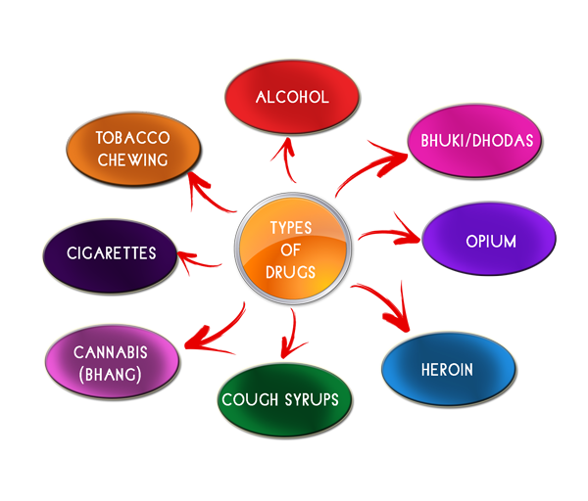

Slide 6
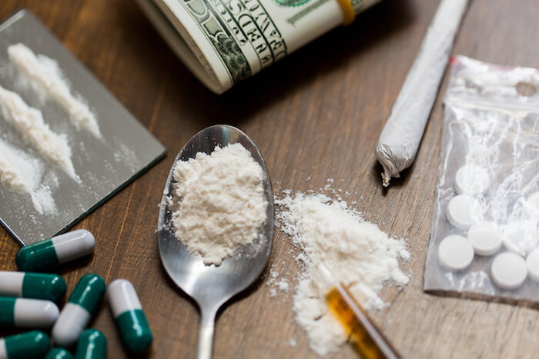

Slide 7
WHY DO PEOPLE TAKE
DRUGS?
To feel good
To feel better
To do better
Family Pressure
Social Pressure
Academic Pressure

Slide 8
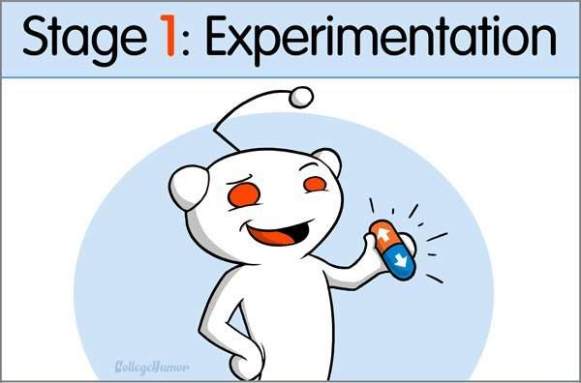
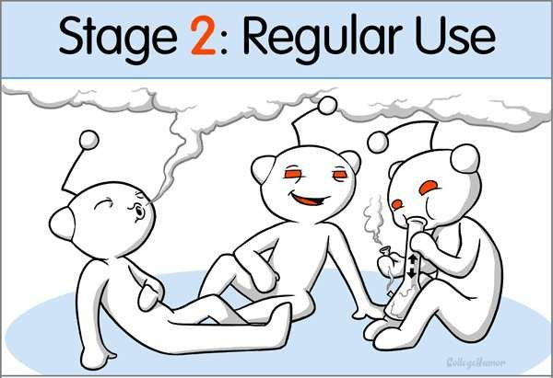
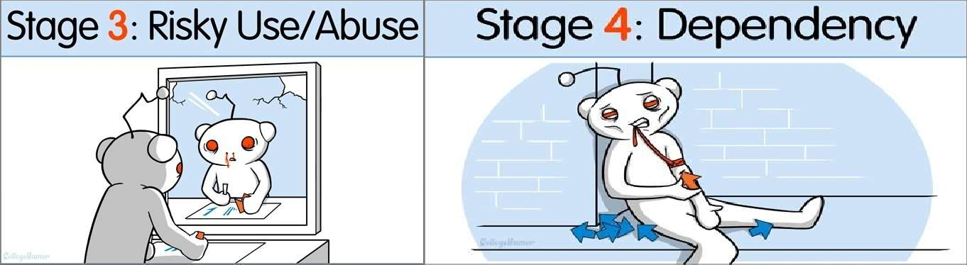

Slide 9
SYMPTOMS OF DRUG ADDICTION
Behavior Change
Neglecting or losing interest in activities
Relationship difficulties
Employment Issues
Health Problem
Academic Issues
Avoiding people

Slide 10
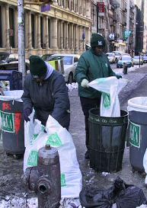
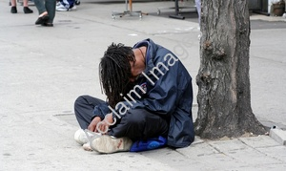
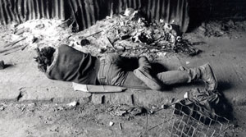
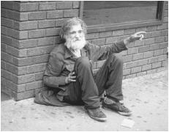
HOMELESSNESS

Slide 11

SIDE EFFECTS
CHEST PAIN
IRREGULAR HEARTBEAT
COLD/BLUISH FINGERS
DIFFICULTY IN URINATING
CHANGES IN BODY TMPERATURE
WEIGTH LOSE
HAPATITAS B/C HIV AIDS
HB DOWN
BLOOD PRESURE

Slide 12
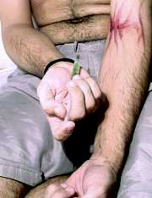
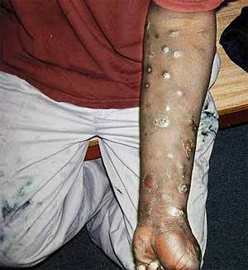
PHYSICAL EFFECTS

Slide 13
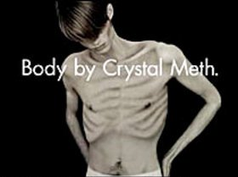
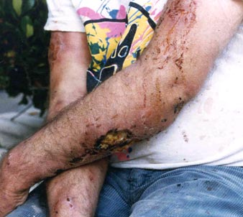
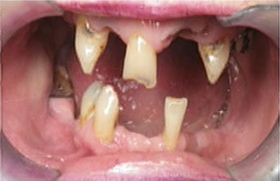
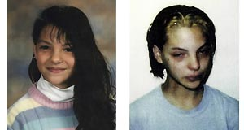
PHYSICAL EFFECTS

Slide 14
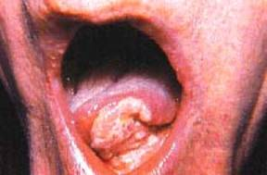
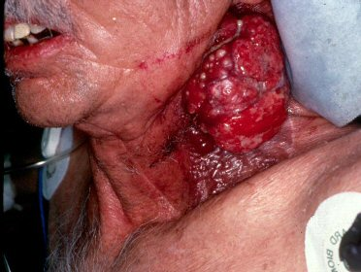
PHYSICAL EFFECTS

Slide 15


Slide 16
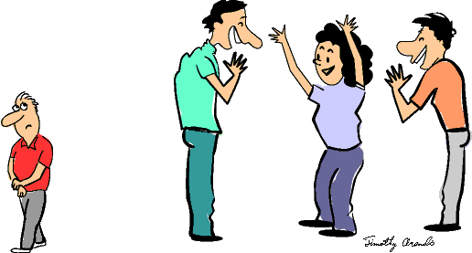
RISK FACTORS
Friends who use drugs (this is the number one predictor of who will experiment with drugs/alcohol)

Slide 17
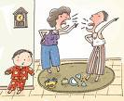



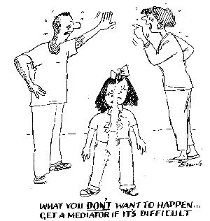

RISK FACTORS
Family management problems
Ignorance
Lack of communication
lack of monitoring
excessive discipline
negative communication patterns
poor anger management

Slide 18
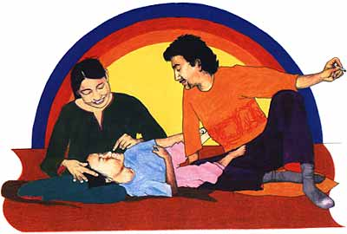

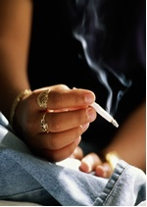
RISK FACTORS
Parental drug use and a positive attitude toward use

Slide 19

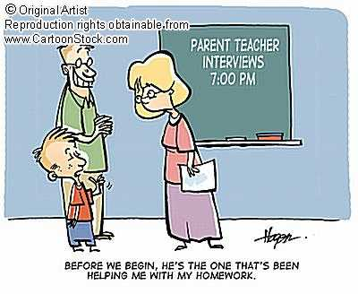


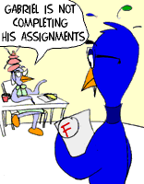
RISK FACTORS
Academic Failure (low and failing grades)
Little commitment to school

Slide 20
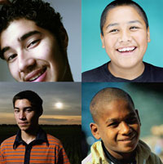

RISK FACTORS
Favorable attitude towards drug use
Early first use of drugs

Slide 21


PROTECTIVE FACTORS
Involvement in alternative activities
Sense of well being and self-confidence

Slide 22


PROTECTIVE FACTORS
Positive future plans
Healthy coping strategies to deal with stress
Positive attitude towards learning

Slide 23



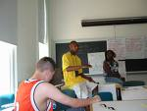


PROTECTIVE FACTORS
Positive relationships with adults

Slide 24
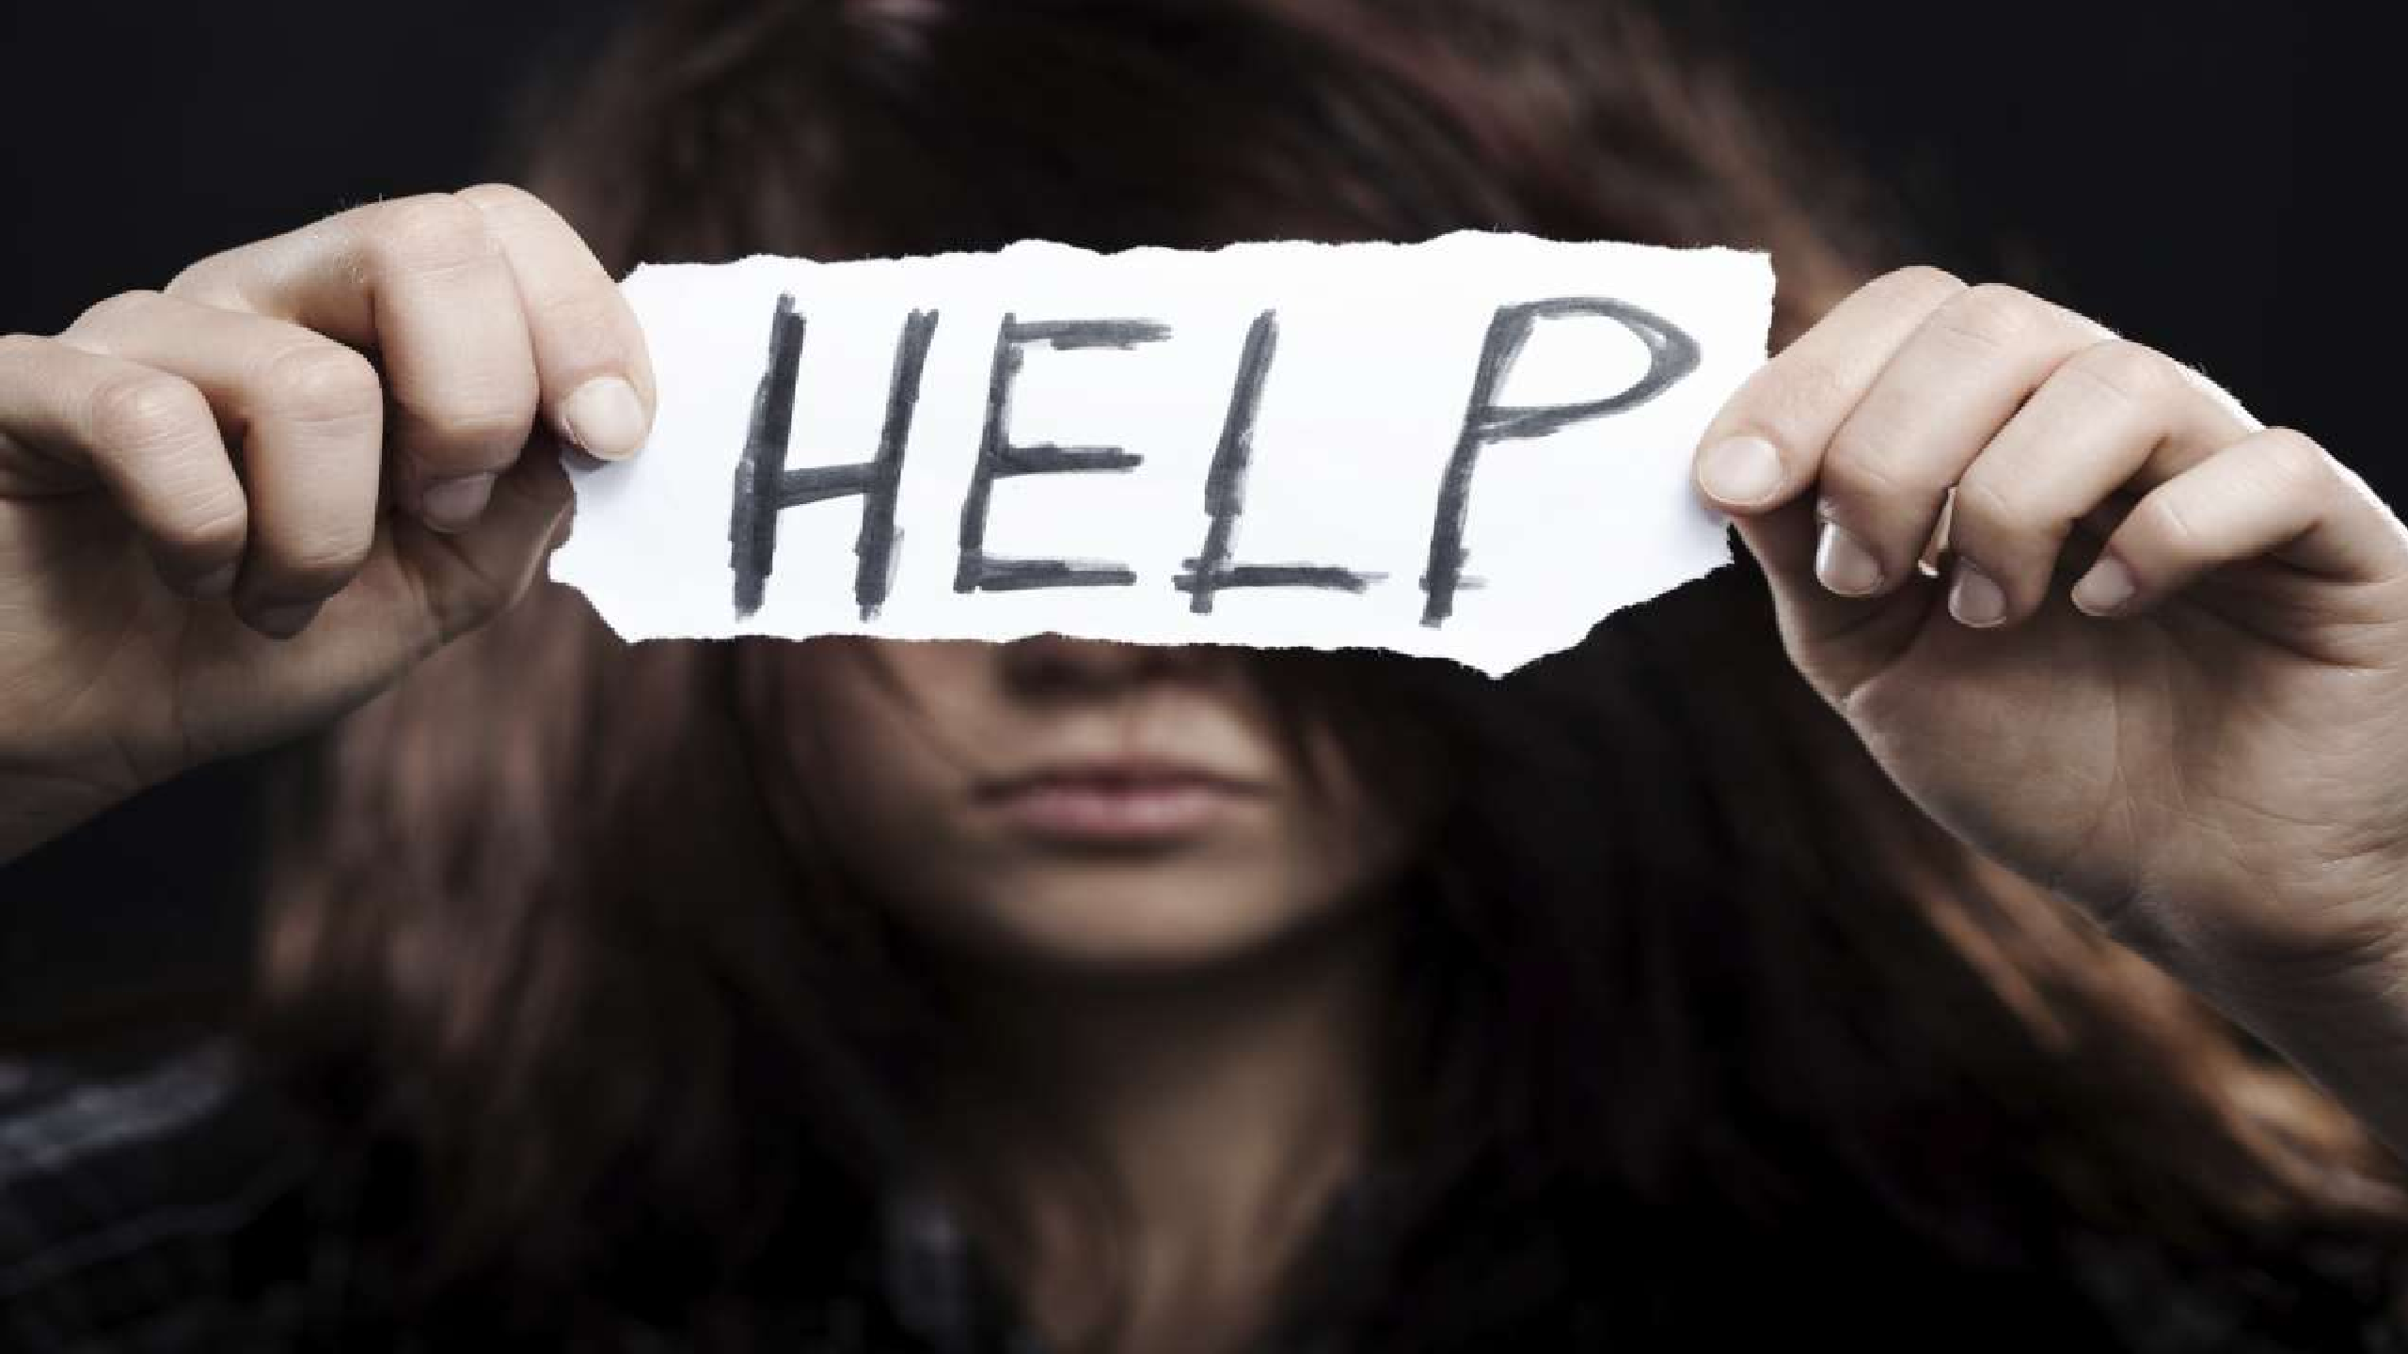
OVERCOMING DRUG ADDICTION
Decide to make a change:
Who you allow in your life.
What you do in your free time.
How you think about yourself.

Slide 25
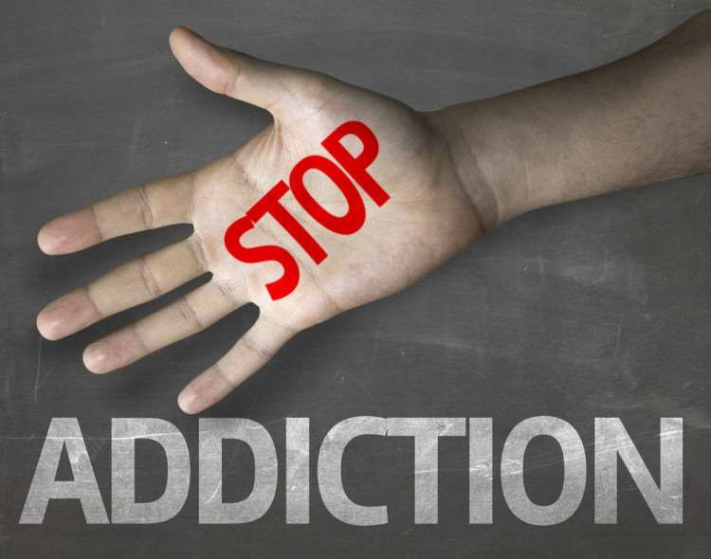
BUILD A MEANINGFUL DRUG FREE LIFE
Pick a new hobby
Get involved in your community
Set meaningful goals
Look after your health
Spend time with your family
Think Positive

Slide 26
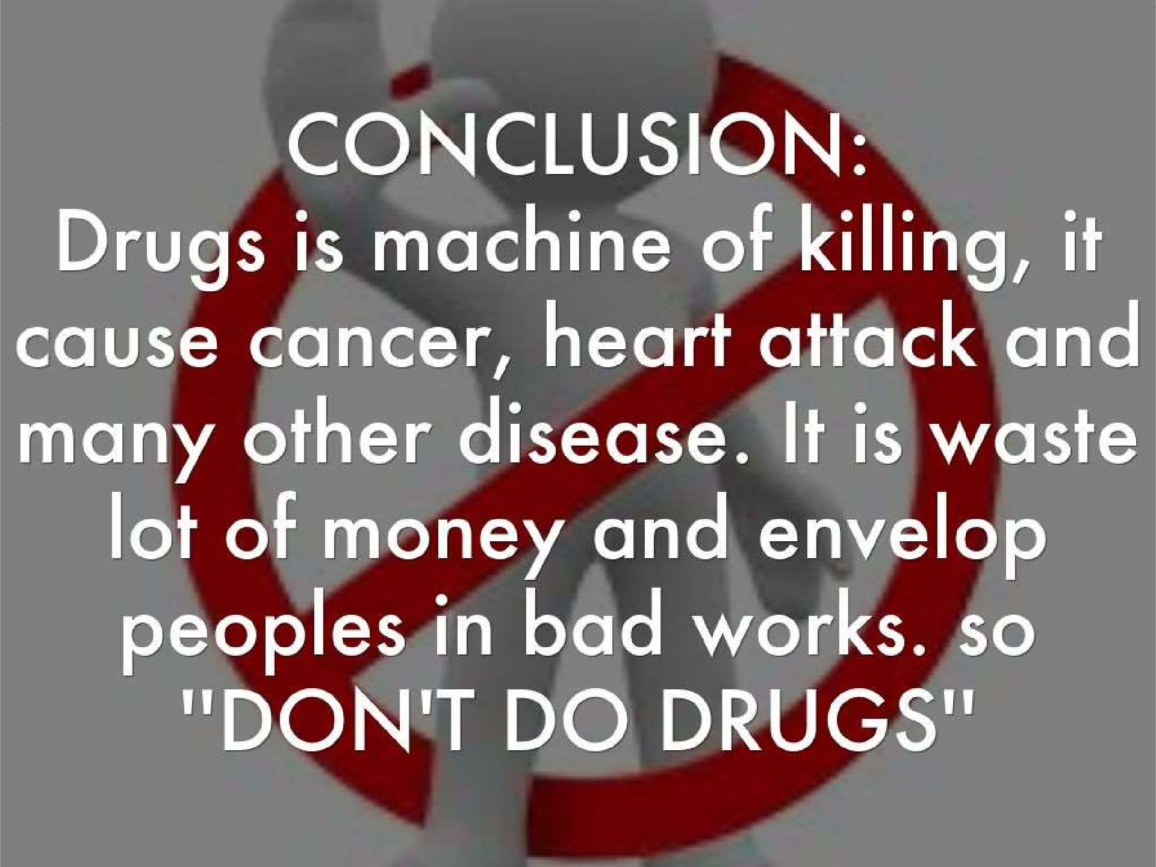

Slide 27
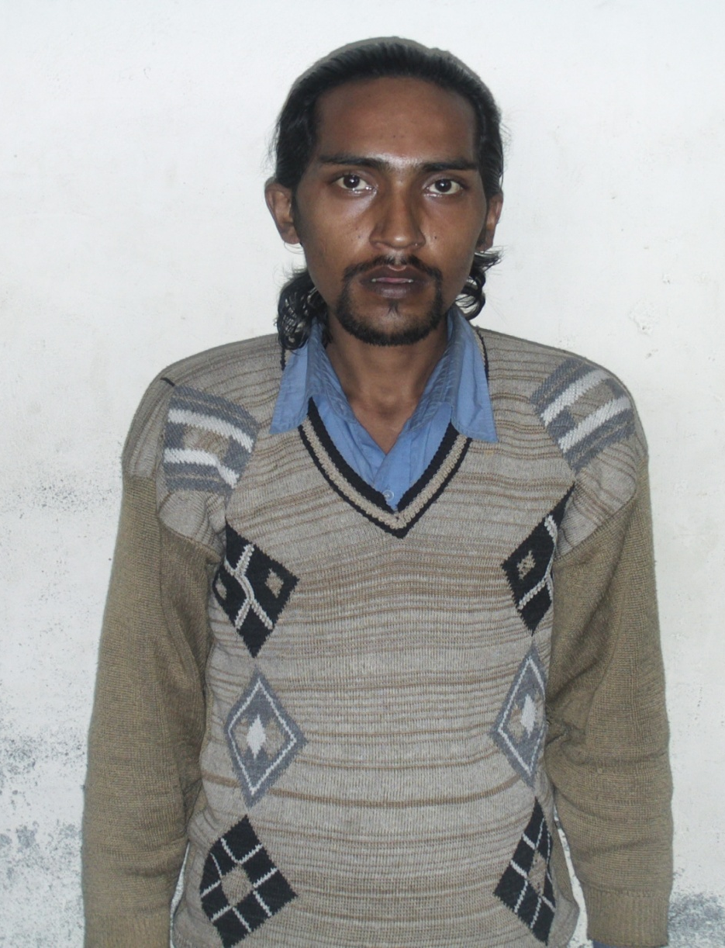
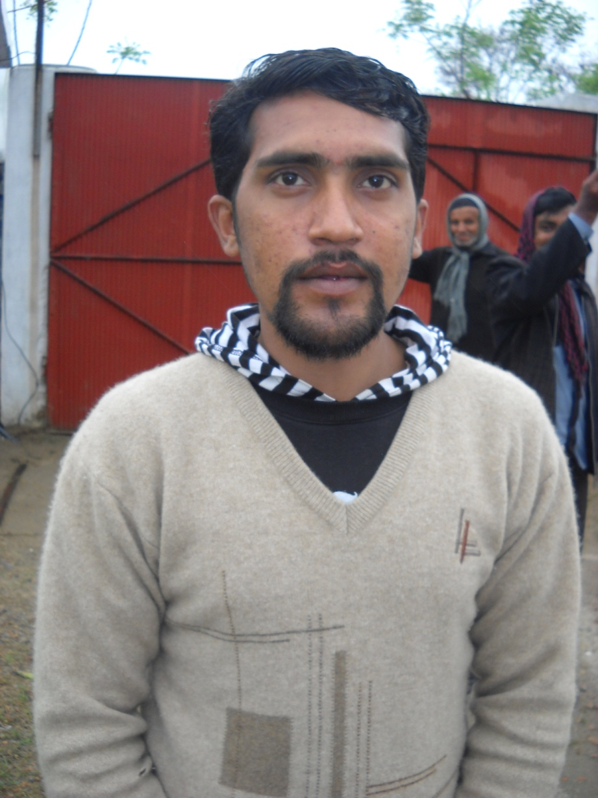
Mr.Micheal
Age 22
Before
After

Slide 28
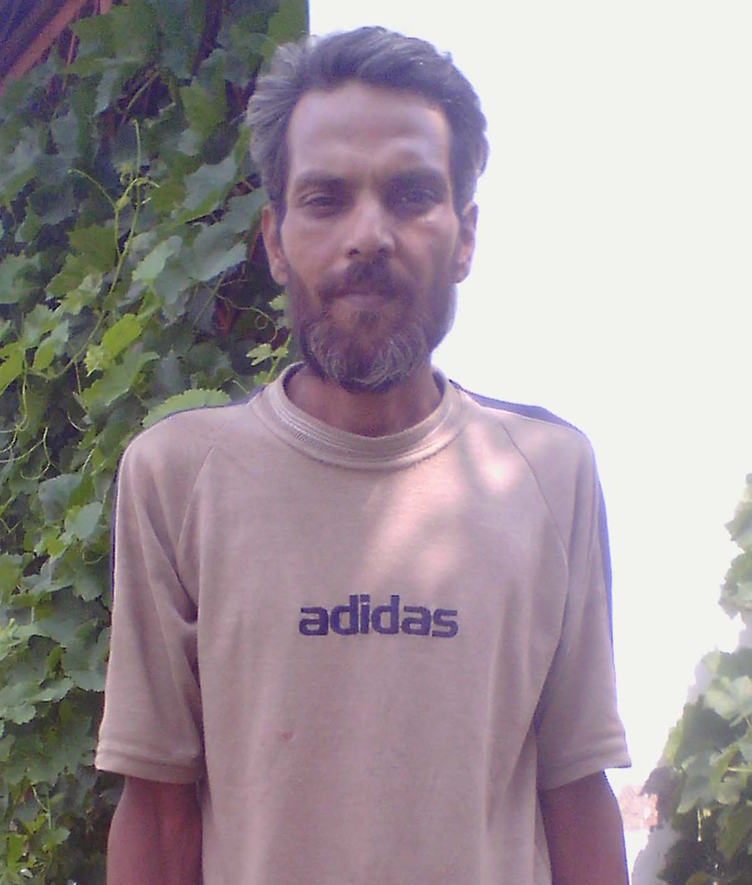
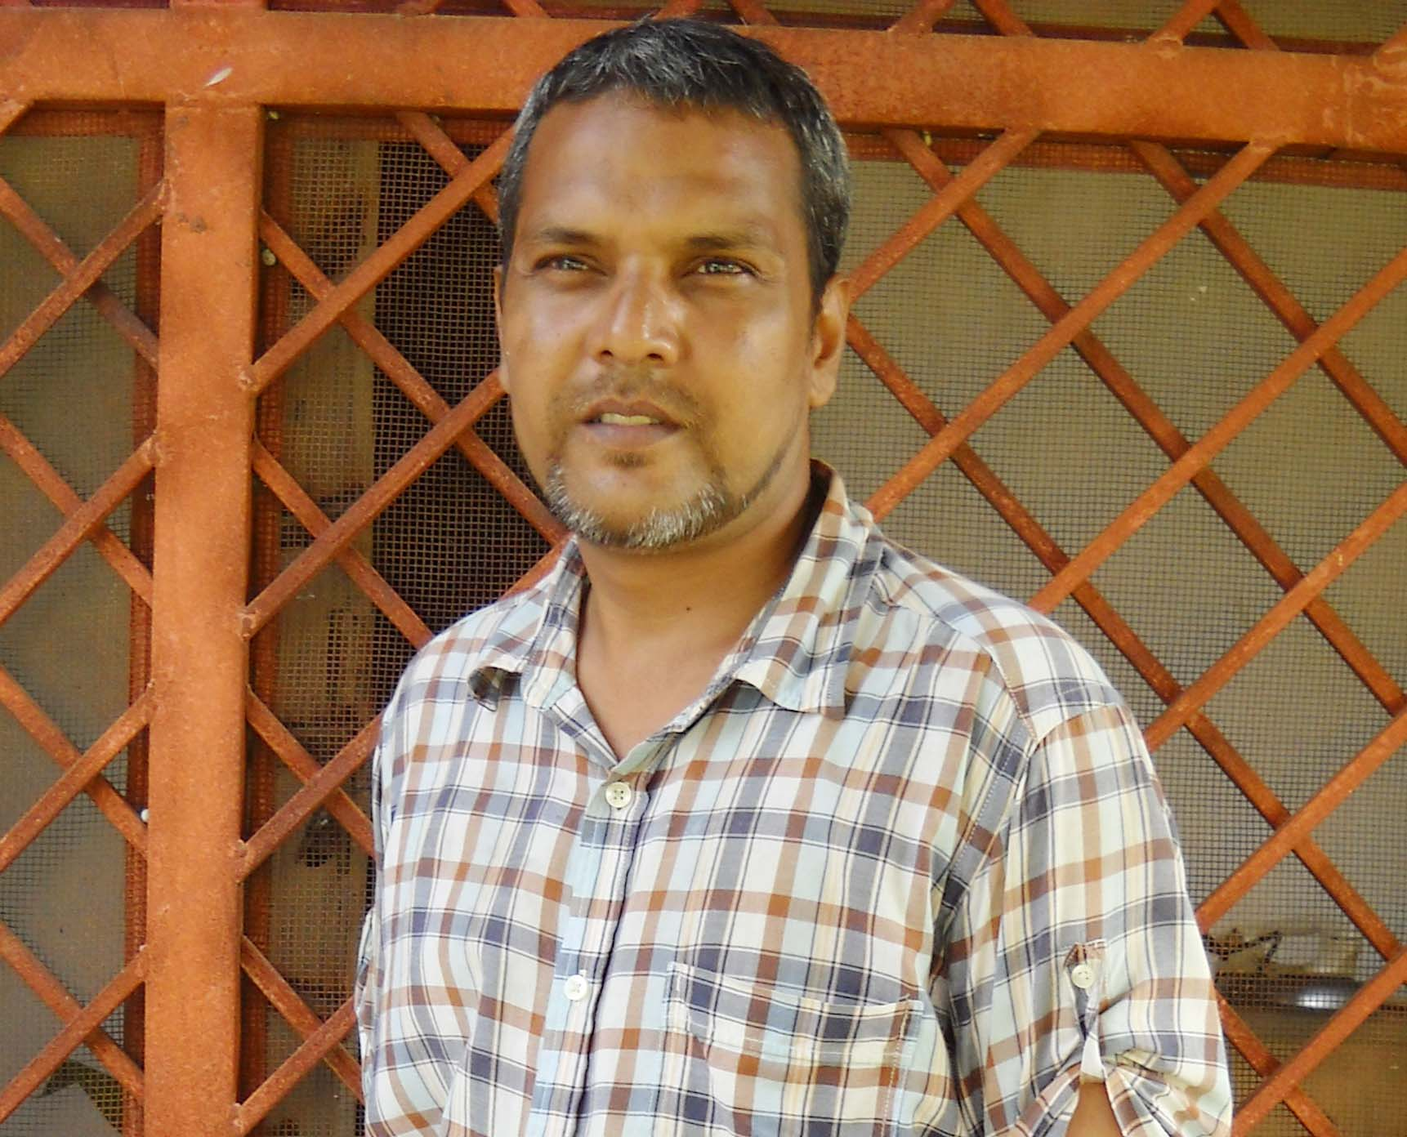
Mr.Qamar
Age 25
Before
After

Slide 29
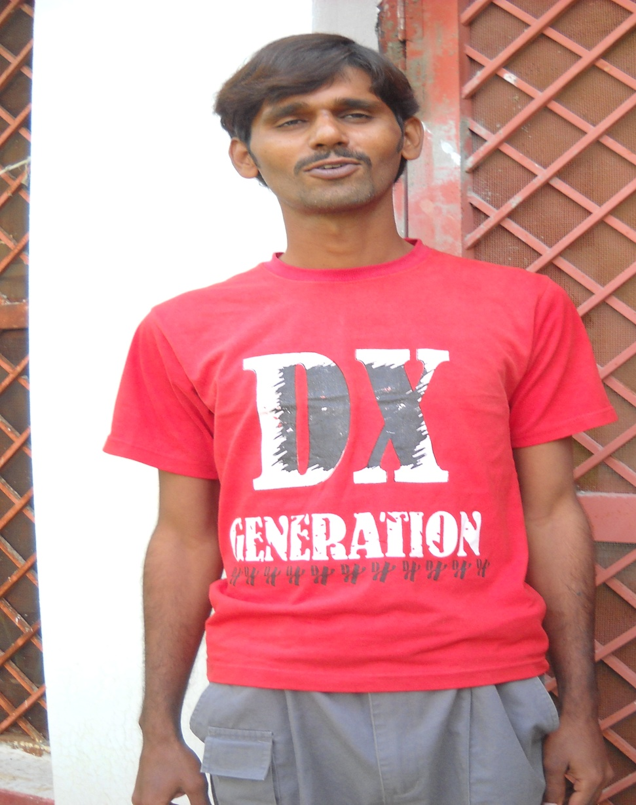
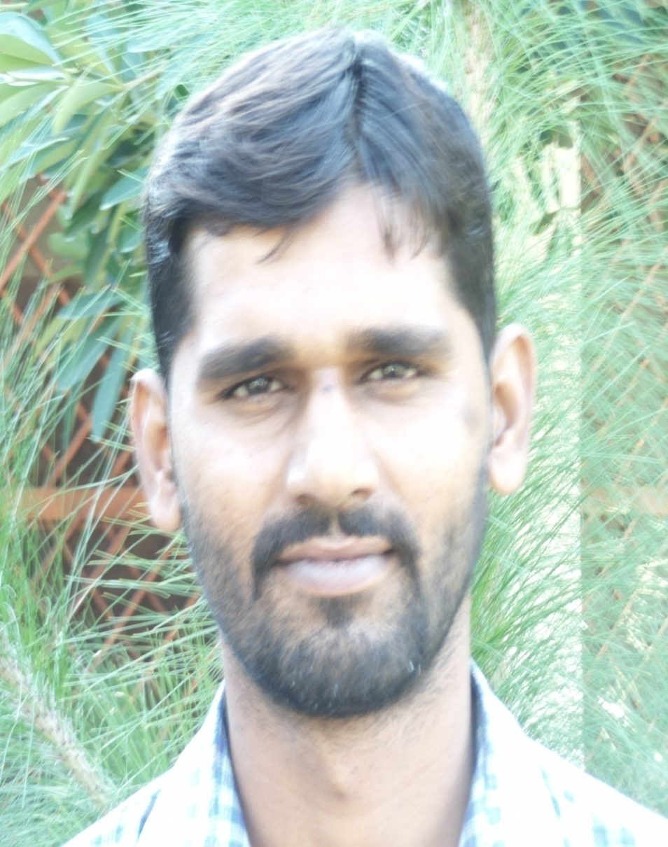
Mr.Adress
Age 21
Before
After

Slide 30


Slide 31

Asif Shahzad
Director Awareness Program
Umeed Development Organization
+92-3027393031
Whatsapp+92-3480596677

