Slide 1


Slide 2
Who Helps The Helper?
A Skills Transfer Program for Behavioral and Substance Use Professionals.

Slide 3
Outline
Introduction
A Global Perspective
A Kenyan Perspective
The Mental Health Milestones
A Clinical Perspective
The STP Program
Call to Action
Conclusion

Slide 4
Introduction

Slide 5
How I almost changed my career
Burn-out results from chronic workplace stress. It is characterized by energy depletion or exhaustion, a person may experience increased mental distance from one’s job, feelings of negativism or cynicism related to their job and reduced professional efficacy.
(World Health Organization)

Slide 6
How Did We Get Here
The mental health crisis was here long before the Covid-19 pandemic.
For decades senior practitioners have actively engaged in different programs in the community.
By 2018 there was already a significant difference how many Kenyans viewed mental health services.
Then we had adequate time for weekly peer supervision sessions where we discussed clinical matters, personal development and aspirations for the future. What stood out was the peculiar trend of Kenyans in the diaspora. Self diagnosis among our clients and how the mental health field was quickly evolving because of technology. We often asked ourselves if we were ready for the inevitable.

Slide 7
The use of internet witnessed a rise in the number of enquiries and requests for specific mental health services.
By the time the first COVID-19 case was announced in March, 2020.
The requests for therapy services was already on an upward trajectory.
Therapists were exposed to the risk of burnout, inconsistent supervision sessions inevitably this factors have created a major gap in monitoring our work and holding each other accountable due to the lack of regular peer supervision .
Presently, the need to have more therapist is rising and many are taking up psychology as a course. This pattern is similar to 1960’s and 1970’s in USA when many students enrolled in psychology as a major..

Slide 8
A Global Perspective

Slide 9
Data from the Covid -19 practitioners impact survey in 2022.
Reported that 60% of psychologists had no openings.
Over 40% had waiting lists of 10 or more patients and nearly 50% of the 2,295 psychologists agreed or strongly agreed they were burned out. American Psychological Association Vol. 54 No. 3 Print version: page 28.
As mentors of students in practice and research we envision that our mentees will be happy, scientifically rigorous and perhaps continue working with you for a long time. But this is usually uncertain, they might at some point change their minds about their career, pursue further studies or choose to start their practice, most of the time we are caught off guard, not prepared to let go, But how do we recover from the loss? Do we ever recover?

Slide 10
A Kenyan Perspective

Slide 11
The Problem
The past 3 years many local newspapers in the country have reported work stress and depression is the main reason for death amongst health workers.
On February 8, 2023, a press briefing by the Kenya Medical Practitioners and Dentists Union (KMPDU) confirmed the media reports and even provided statistics.
A study by the Aga Khan University that interviewed 4,000 nurses, midwives and community health volunteers between 2021 - 2022 that sought to highlight the resilience of frontline health workers in the 47 countries. It established 1 in every 4 health care professionals exhibited signs of depression.

Slide 12
The Milestones
The Generation Z and Millennials.
They have been on the forefront in the fight against stigma and discrimination. They’re frank, honest and bold. They encourage the public, peers and parents to seek help. Many are accompanied by parents for family therapy.
The Board
The Counselors and Psychologist board is in the process of registering all psychologists in Kenya.
The board mandate is to regulate the profession and practice.

Slide 13
The Task Force Report.
The Mental Health Task force which was established on December, 2019 recommended that the government declares mental health a national emergency of epidemic proportions.
The Social Health Insurance
The Social Health Insurance bill which was launched on October 2023 will extend health insurance to all Kenyans with the government subsidizing coverage for the poor.

Slide 14
A Clinical Perspective

Slide 15
A survey conducted at our facility between 2020 to date shows that the number of mental and physical health professionals seeking therapy is going up.
We have become too busy to the point we hardly have time to meet for supervision. Unlike, 2018 when we could meet for an hour every week. During Covid-19 this dwindled. Fortunately the online weekly clinical supervision session called the grand round gave reprieve to many clinicians and an opportunity to learn.
.
Is it time to rethink how mentorship, supervision and peer support works?

Slide 16
The Skills Transfer!

Slide 17
The STP program was inspired by the senior mentors, seasoned practitioners the generation-z and our clients. The first cohort commenced in October, 2021.
The goal of the program is to transfer skills you can learn in one context and transfer to other domains of life.
Learning and transferring of life skills is viewed as an interconnected and developmental process at any stage in life.
Our program is anchored in the third wave cognitive Behavioral approaches to therapy.

Slide 18
Who Can Benefit From STP
Students
Psychologists that want to come back to the field.
Develop skills to avert burnout and high turnover of psychologists
Those that want to start private practice.
Those that want to learn skills to avert burnout..
Those that need a network of competent behavioral and substance use professionals who speak the same language.
Influencers, Jua Kali professionals, Managers that want to learn a set of tools that they can use to help their colleagues at work.

Slide 19
How it Works.
1. Application
2. Interview
3.Orientation and welcome ceremony.
4.Hand holding (big sister or brother)
5. Curriculum
6. The game changer stage ( 3 months to learn the ropes and decide if the program is a fit)
7. Mastering the skills ( observing the supervisor, peer support, self care techniques. Exploration stage, what works? What does not, hand holding pacing, self monitoring, feedback from your peers,
8. Sessions are currently twice a week.
9. Free program
10. Duration is 1 year.

Slide 20
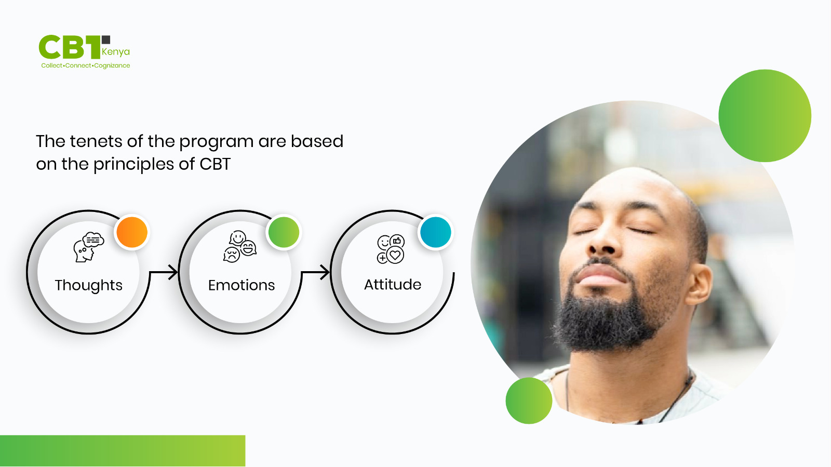
How it Works

Slide 21
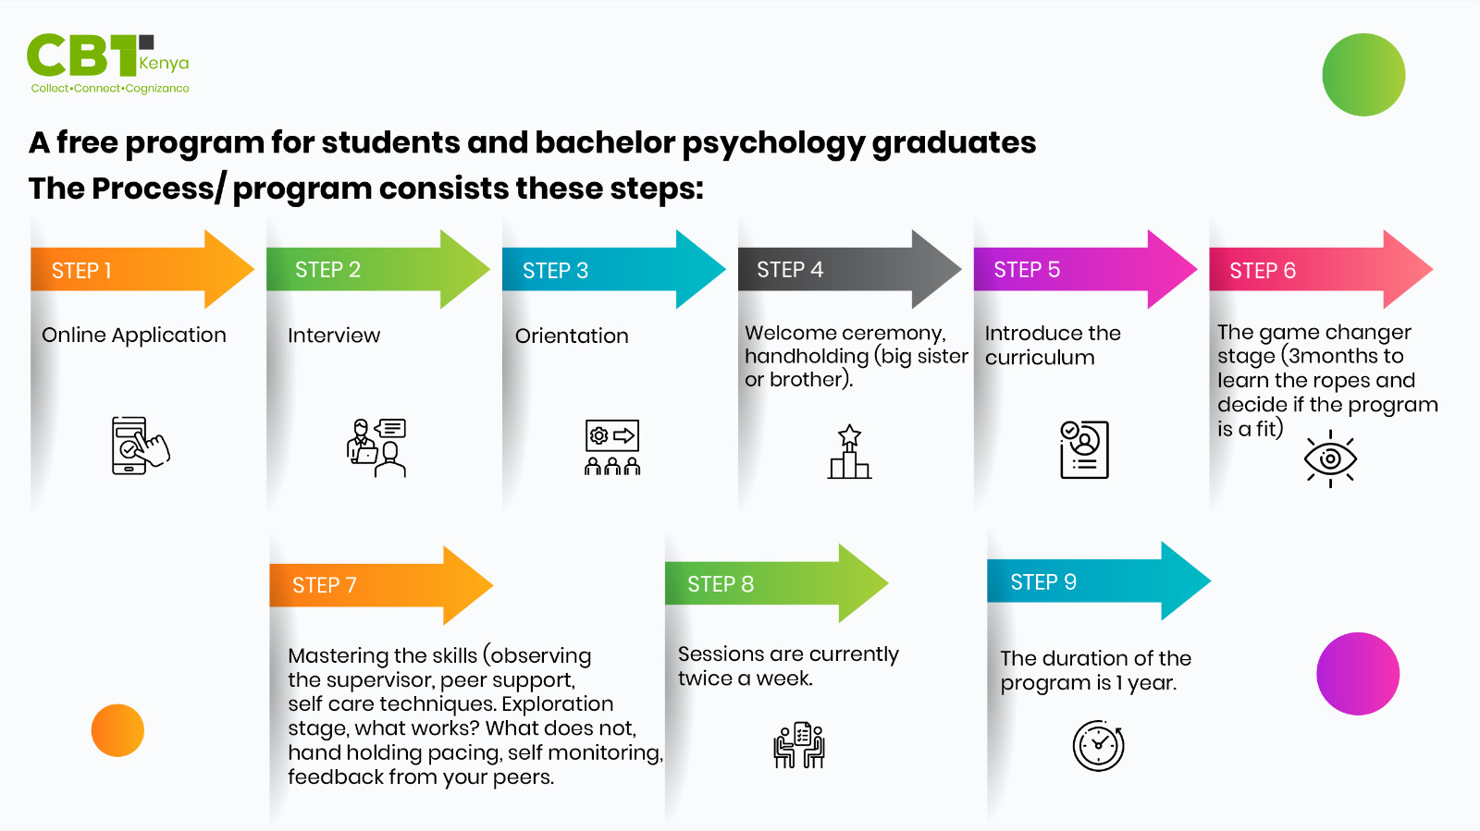

Slide 22
Call To Action.

Slide 23
Let us Collaborate
Let us committee to work together to build capacity in our communities.
Sensitization
Let us educate the public and ourselves about the evidence based approaches..
Let us create safe spaces where professionals can be vulnerable. After all we are not superhuman. let us teach and handhold influencers, physical health professionals, Jua kali( informal sector), business owners, pastors, Imams managers, senior citizens.

Slide 24
Research and Support
Is it possible to work with researchers to crowd fund resources to establish and programs for therapists.
Can we build a global network of senior and upcoming mentors to ensure the principles and standard of ethical practice is maintained?
At CBTKENYA we are well aware that you alone can do it, but you can’t do it alone.

Slide 25
Thank you!

