Slide 1
Females with SUBSTANCE USE and Society: The Do’s and Don’t’s of NLP and Hypnosis
Presenter:
Dr. Nazish Idrees, Ph.D.
Clinical Psychologist, Certified Hypnotherapist, Addiction Therapist
Faculty of Allied Health Sciences,
The University of Lahore
Notes:
3-6-22 Friday

Slide 2
LIST OF CONTENTS
TO BE DISCUSSED
AIM of today’s webinar
Substance use and females
Understanding how society affect women with SUD?
NLP and Hypnotherapy
The role therapy plays: Do’s and Don’ts
Let’s do an activity!
Q/A session
Notes:
Enlist one to 6 examples of PF benefit for addiction

Slide 3
The International Day Against Drug Abuse and Illicit Trafficking
June 26, 2022

Slide 4
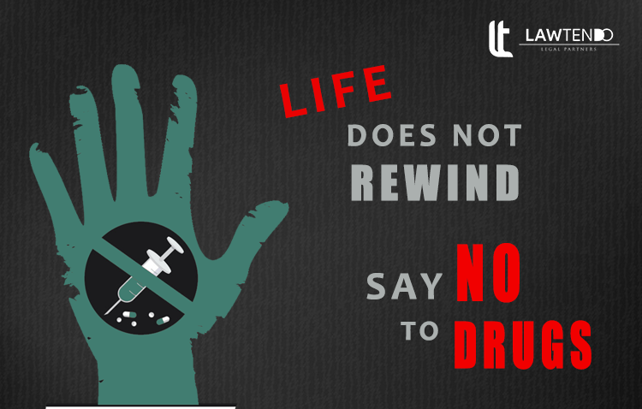
AIM
To create support
1/3th users
To facilitate into treatment
1/5th
To save all of them!

Slide 5
Females are at risk!
In 2022, it was found that females are facing unemployment and increased stress from childcare responsibilities than men.
Women with these experiences may be at particular risk for mental illness and increased substance use.
Anxiety and changes in daily life due to the stressors and high-risk substance use are related to greater mental health–related distress among women.

Slide 6

SUD and Females
Challenges that makes females more vulnerable to:
Gender based violence
Sexual Abuse/forceful sex work
High rates of incarceration
Economic discrimination
Child care issues
Comorbidities
Stigma
Notes:
Family Unit means a group of individuals residing together who are related by birth, marriage, or adoption or an individual who does not reside with another individual to whom the individual is related by birth, marriage, or adoption.

Slide 7
Society’s influence
Outcomes
Barriers to treatment
Continued Victimization
Significant decline in healthy functioning

Slide 8
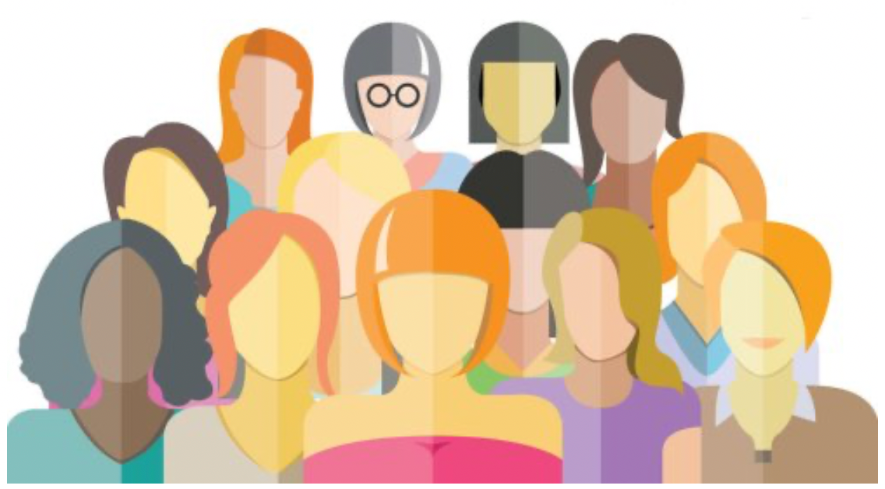
Reasons behind SUD among Females
Pressure to use by intimate drug user partners
Peer pressure
Stressful family/environmental factors
Relationship/social difficulties
Workplace issues
Illness or trauma
Self-medication
Notes:
Family Unit means a group of individuals residing together who are related by birth, marriage, or adoption or an individual who does not reside with another individual to whom the individual is related by birth, marriage, or adoption.

Slide 9
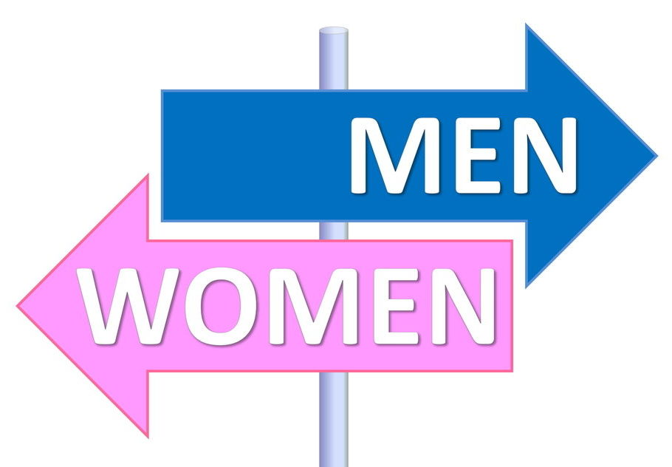
For females: it is different than males
Quick progression
Role expectations and structural issues
Severe clinical profile
Greater impairment with less use
Higher suicidal behaviors
Later age complexities

Slide 10
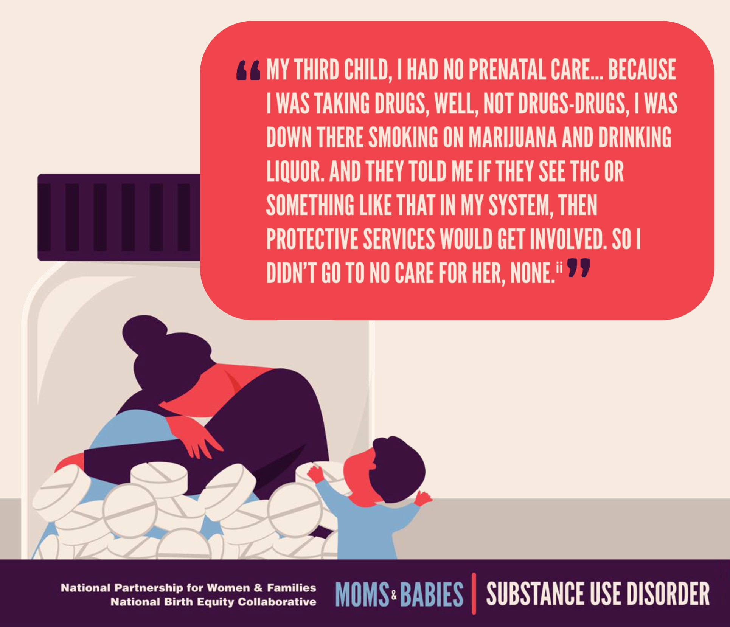

Slide 11
NLP and Hypnotherapy
Evidence based treatments
NLP is method of communication in a certain way that people can perceive based on sensory experiences
Hypnosis is an altered state of consciousness, known as a trance state, which is deliberately induced by a hypnotist or hypnotherapist on another individual person or group of people. The change in consciousness that occurs under hypnosis is more than just a feeling, it can actually be measured and observed. In the hypnotic state, the subject is more open to suggestion.
Notes:
on the EEG readings of the brains of hypnotic subjects.2﻿

Slide 12
Do’s and Don’ts
Notes:
A chronic condition is a human health condition or disease that is persistent or otherwise long-lasting in its effects or a disease that comes with time. The term chronic is often applied when the course of the disease lasts for more than three months.

Slide 13
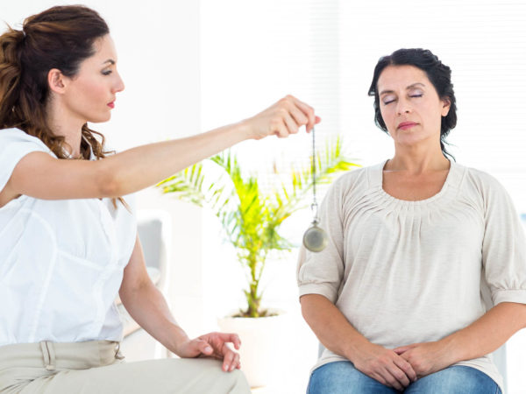
The role of therapy, Do’s
Can be used in treatment plan in addiction to other interventions
Hypnotic suggestions must be given by a certified therapist
Can be used to improve insight, focus on problems and motivation to deal with induced symptoms

Slide 14
Willingness
Potential
Change

Slide 15

The role of therapy, Don'ts
Expect that it will swish addiction in brief sessions
Expect that it will control the use of substance
Expect that it is a magic or stage performance

Slide 16
TYPES

Slide 17
Authoritative
Active in the process
Permissive
Passive
Listens and follows
Self-hypnosis
Practice of inducing hypnosis on self
Not guided by other person
Seek suggestions

Slide 18
Stages

Slide 19
Absorption
Dissociation
Trance
Notes:
Deep concentration and imagination
Separating other aspects than the suggestion and indicate with hand
Controlling acceptance of suggestions

Slide 20
List down any ideas you have to reduce societal influence for a smooth treatment process
Activity

Slide 21
Use with other interventions
May deal with symptoms
Works like magic
May improve insight
Swish all addiction at once
Given by trained therapist

Slide 22
Further Needs to Implement
Prevention strategies
Treatment
Social integration
Capital maximization
Recovery
Relapse Prevention

Slide 23
Comments and suggestions Time!
Questions?

Slide 24
References
https://www.webmd.com/mental-health/addiction/what-to-know-hypnosis-alcoholism
https://pubmed.ncbi.nlm.nih.gov/18935753/
https://www.verywellmind.com/hypnotherapy-treatment-for-addiction-4120753
https://pubmed.ncbi.nlm.nih.gov/15376606/

Slide 25
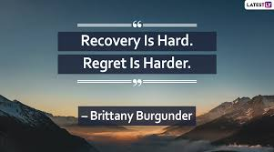
Notes:
Temporary influences due to emotional surges

Slide 26
THANK YOU!
For More Information or Appointments!
Nazish.idrees@rsmi.uol.edu.pk
Certified Addiction Treatment Professional UTC by DAP and Colombo Plan, 2022 Certified Addiction Prevention Coordinator in UPC Training by UNODC, 2019
Trained in Addiction Recovery Support, HIV assessment and Counseling by Phoenix Foundation, 2018
Member International Society of Substance Use Professionals & APA
President ISSUP Lahore Chapter Pakistan Youth Team
Project Coordinator and External Supervisor for Fellowship Program for Addiction Professionals by Civil Society

