Slide 1

Evidence-based medicine. Dual pathology, multidisciplinary approach.
Dr. Ramiro Velez Sagarnaga.
REGIONAL DIRECTOR CIJ CHIHUAHUA

Slide 2
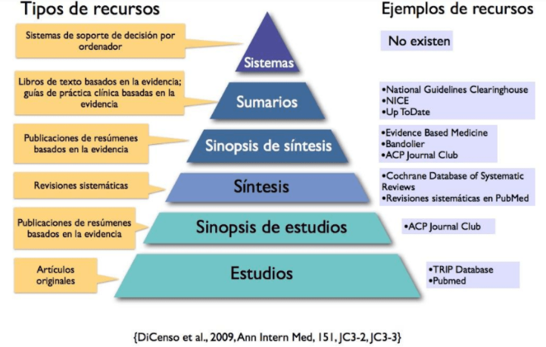
MEDICINA BASADA EN EVIDENCIA
Pyramid of the 6 S of evidence

Slide 3
What is it?
EVIDENCE-BASED MEDICINE
Process through which the health professional makes their clinical decisions integrating the best available scientific evidence, their professional experience, as well as the values, preferences, characteristics and circumstances of the person in care.

Slide 4
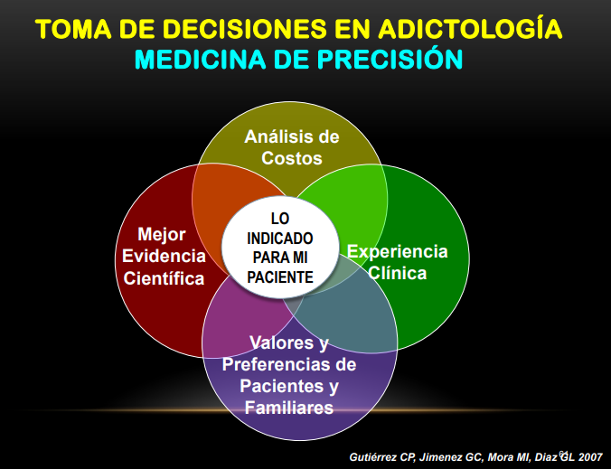

Slide 5
Steps / Process
1.- Ask a question.
2.- Locate the best available evidence.
3.- Critically analyze the evidence.
4.- Apply the evidenced.
5.- Evaluate the progress of the person in care.

Slide 6
1.- Generate a question.
PICO SYSTEM
P | Population/Patient
I | Intervention
C | Comparator/control
O | Outcome
For P, "I" is just as effective as "C" to get "O"
Rubin, A &Bellamy, J. (2012) Practitioner’s Guide to Using Research for evidence-Based Practice.USA..John Wiley & Sons.
Glasziou, P. Del Mar, C. % Salisbury, J. (2003). Evidence-based Medicine Workbook. Finding and appling the best evidence to improve patient care. Espana: BMJ Books.

Slide 7
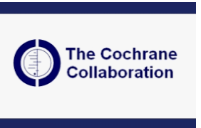
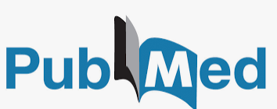

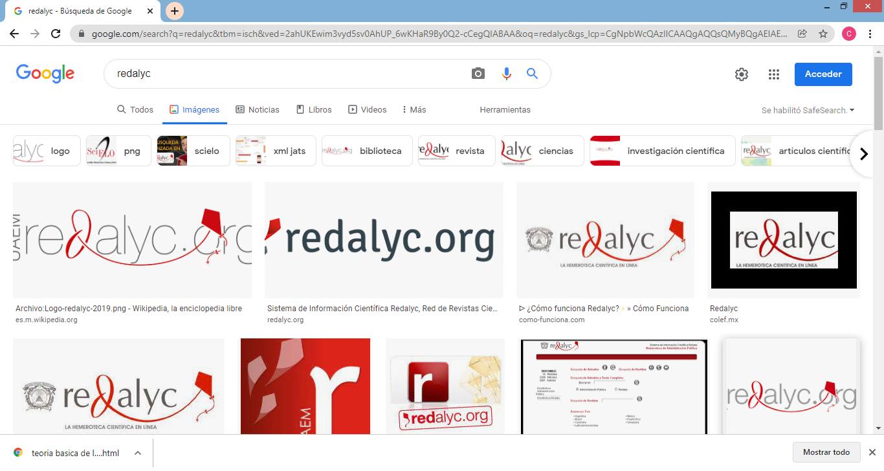
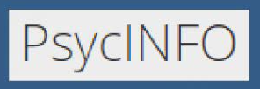
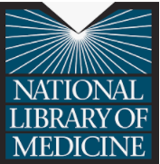
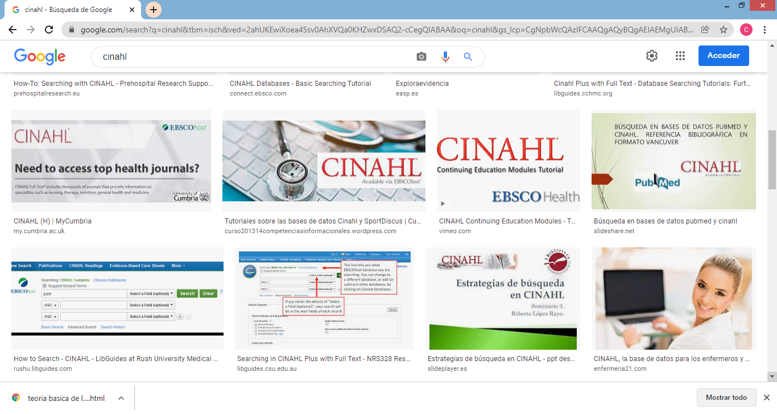
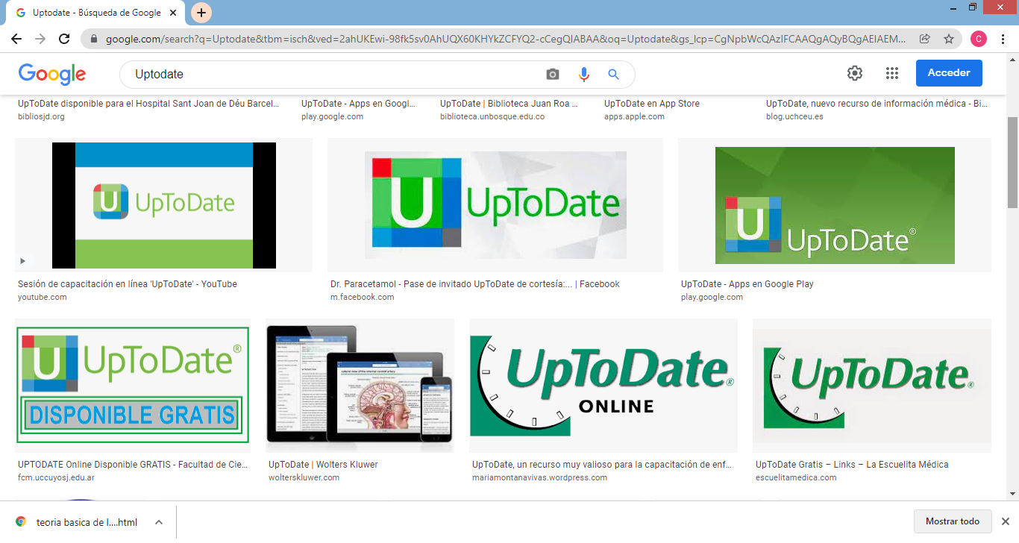
2. Locate the best available evidence.
Rubin, A &Bellamy, J. (2012) Practitioner’s Guide to Using Research for evidence-Based Practice.USA..John Wiley & Sons.
Glasziou, P. Del Mar, C. % Salisbury, J. (2003). Evidence-based Medicine Workbook. Finding and appling the best evidence to improve patient care. Espana: BMJ Books.

Slide 8
3.- Critically evaluation of the evidence.
PRISMA Checklist
CONSORT Checklist.
Equator Network.
Rubin, A &Bellamy, J. (2012) Practitioner’s Guide to Using Research for evidence-Based Practice.USA..John Wiley & Sons.
Glasziou, P. Del Mar, C. % Salisbury, J. (2003). Evidence-based Medicine Workbook. Finding and appling the best evidence to improve patient care. Espana: BMJ Books.

Slide 9
4.- Apply the evidence.
Treatment feasibility.
Viable and available alternatives.
Potential benefits and harms.
Opinion of my patient.
Rubin, A &Bellamy, J. (2012) Practitioner’s Guide to Using Research for evidence-Based Practice.USA..John Wiley & Sons.
Glasziou, P. Del Mar, C. % Salisbury, J. (2003). Evidence-based Medicine Workbook. Finding and appling the best evidence to improve patient care. Espana: BMJ Books.

Slide 10
5.- Evaluate the effectiveness of the process and the treatment.
Rubin, A &Bellamy, J. (2012) Practitioner’s Guide to Using Research for evidence-Based Practice.USA..John Wiley & Sons.
Glasziou, P. Del Mar, C. % Salisbury, J. (2003). Evidence-based Medicine Workbook. Finding and appling the best evidence to improve patient care. Espana: BMJ Books.

Slide 11
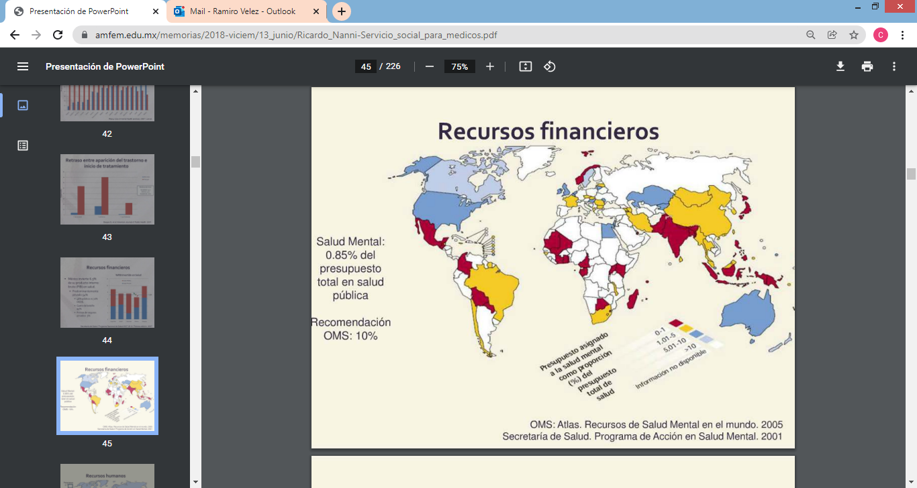

Slide 12

All of the above leads us
Improve our diagnostics (DSM and CIE)
Application of clinical instruments
Professionalization
Approaches through scientific evidence
Multi and transdisciplinary teams

Slide 13
Dual Pathology
It is the comorbidity, concurrence or concomitance of a major psychiatric diagnosis (in Axis I and / or Axis II, according to the DSM-V) with the addiction disorder, generally in the order of pathological consumption and dependence.

Slide 14
The term DUAL would seem to refer to any combination of two conditions, but in psychiatry it has been reserved to define the patients already described in this presentation, for the following reasons:
- High prevalence.
- Its prognostic meaning.
- Diagnostic formulations and decision making.

Slide 15


Slide 16
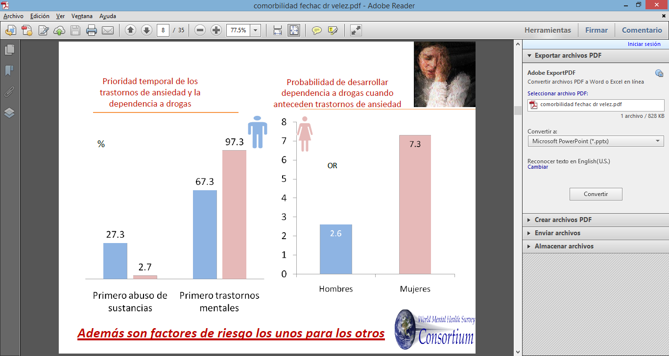

Slide 17
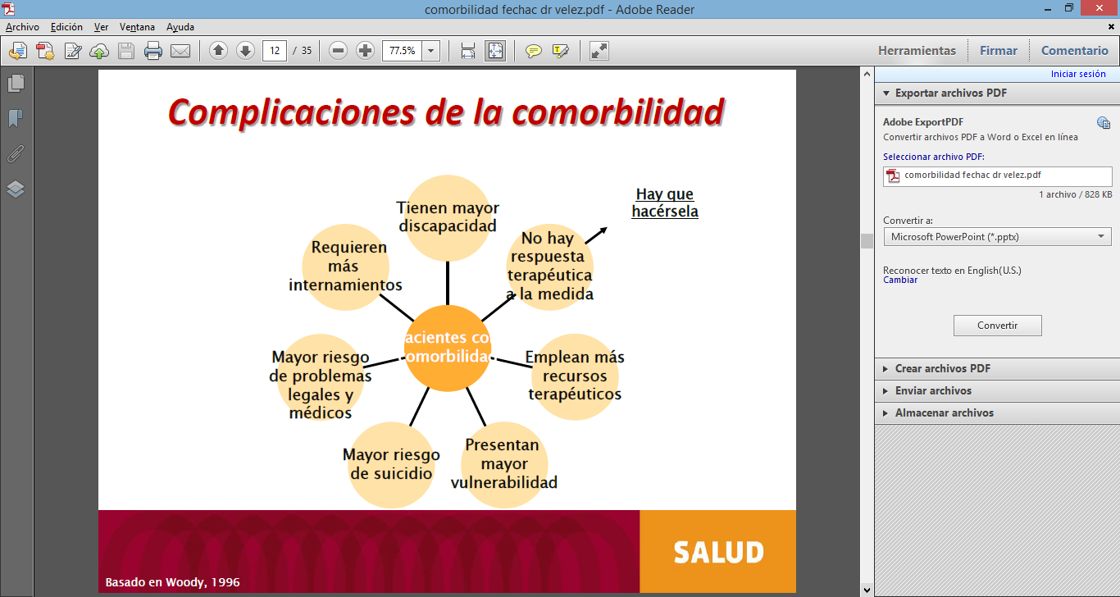

Slide 18
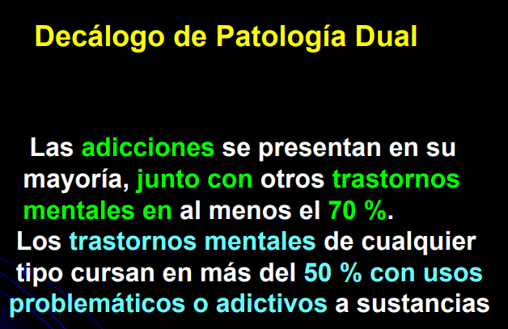

Slide 19
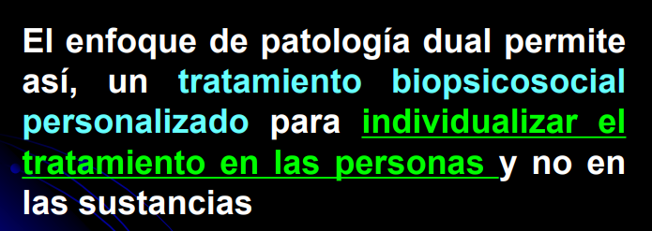
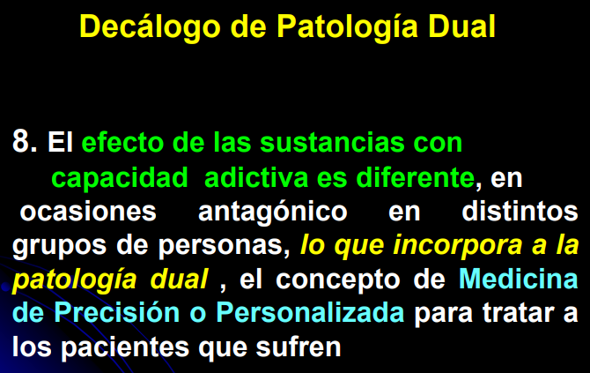

Slide 20
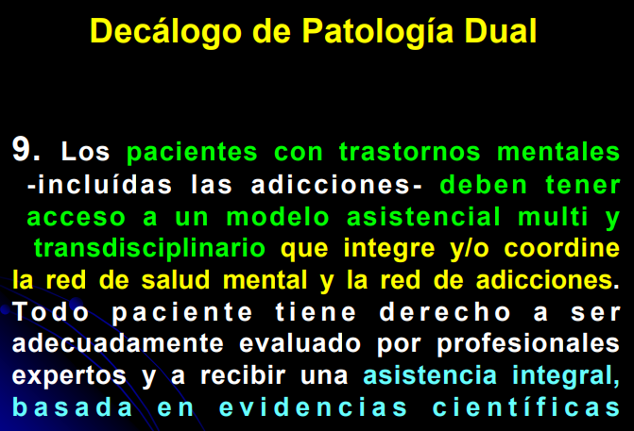

Slide 21
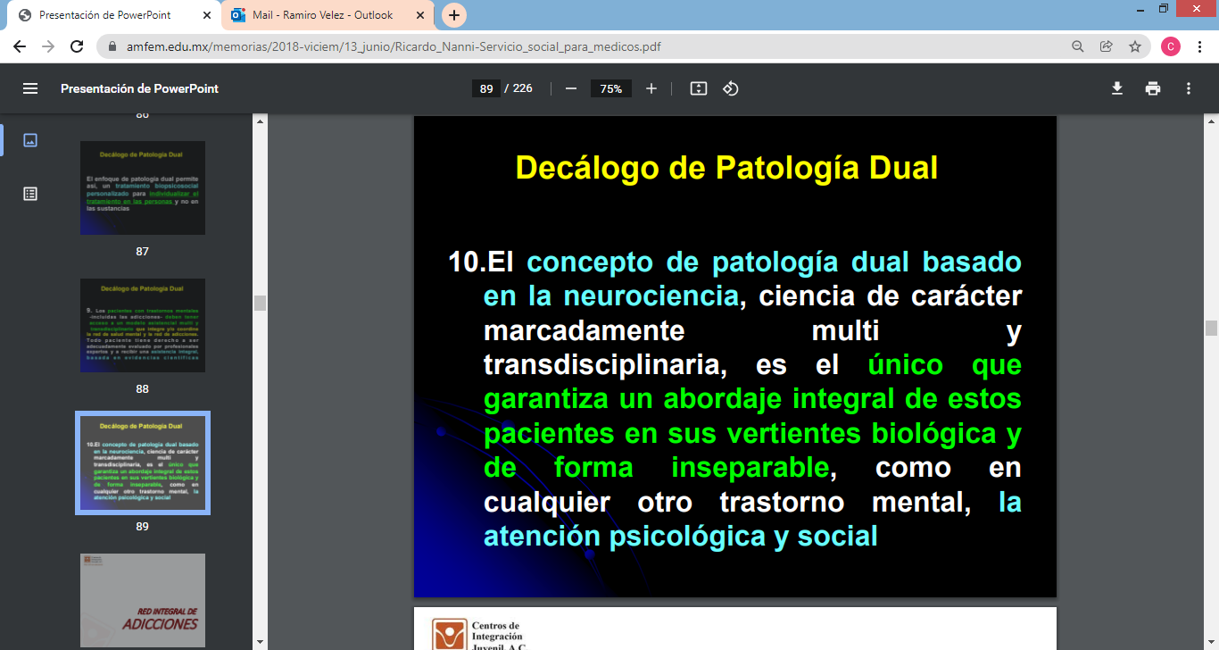

Slide 22
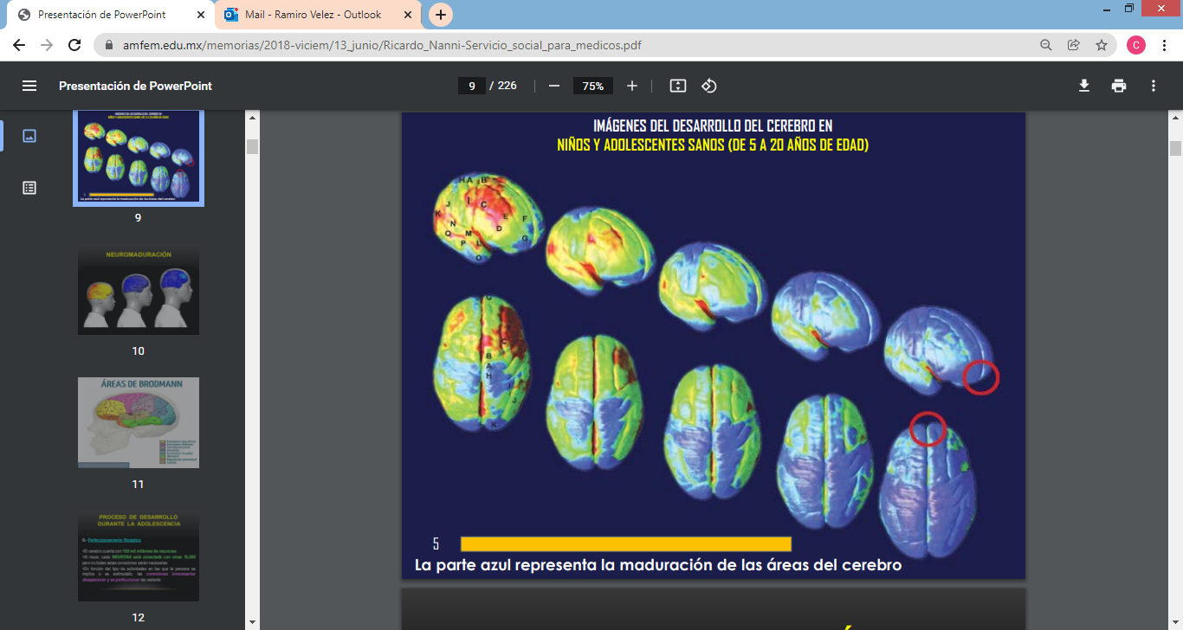

Slide 23
"Drugs are not necessarily chosen for their own freedom, there are a series of vulnerabilities that lead to consumption“
(Gilberto Gerra UNODC, 19th International Congress on Addictions)

Slide 24
1. Torrens, M. (2008) Patología dual: situación actual y retos del futuro. Adicciones, Vol. 20 Num 4 Pags. 315-320. Extraído de: http://www.adicciones.es/index.php/adicciones/article/view/255
2. Santi, B. Casas, M. Diagnóstico Dual. Unidad de Adicciones. Departamento de psiquiatría. Pontificia Universidad de Chile. Pag. 1-34
3. Torrens, M et al. Evaluación de la Comorbilidad Psiquiátrica. Servicio de Psiquiatría y Toxicomanías, Hospital del Mar, Unidad de Investigación en Psiquiatría-IMIM, Universidad Autónoma de Barcelona, Barcelona España. Pag. 463-476
4. Hamilton M. A rating scale for depression. J. Neurol Neurosurg Psychiatr 1960; 23:56-62
5. Hamilton M. The assessment of anxiety states by rating. Br J Med Psychol 1959;32:50-55
6. Overall J., Gorham D. The Brief Psychiatric Rating Scale. Psychological Reports 1962;10:799-812
7. Pérez-Urdániz A., Rubio V., Gómez M. Cuestionario Salamanca de Trastornos de Personalidad . Extraído: http://www.seetp.com./Artículos/SALAMANCAcast.pdf
8. Conners, K. (1969), Farré-Riba y Narbona (1997). Rev Neurol 1997;25:200-4

Slide 25
Thank you for your attention.
Dr. Ramiro Velez Sagarnaga.
REGIONAL DIRECTOR CIJ CHIHUAHUA. cijchihuahua@cij.Gob.mx velezramiro@hotmail.com
52+1 6141843070

