Slide 1

Philippine National Police
Drug Enforcement Group
ISSUES AND REALITIES ON WAR ON DRUGS

Slide 2
Outline of Presentation
Current Realities
Anti-Illegal Drug Accomplishments
Assessment and Updates

Slide 3
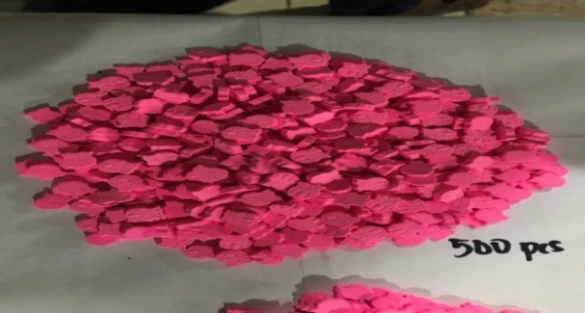
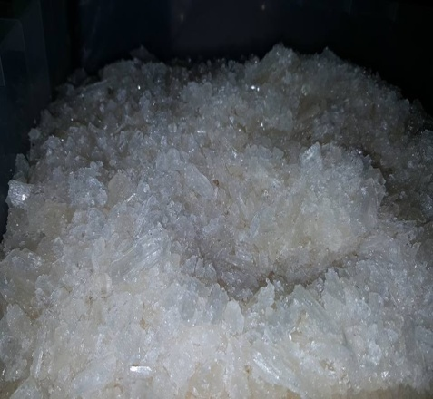
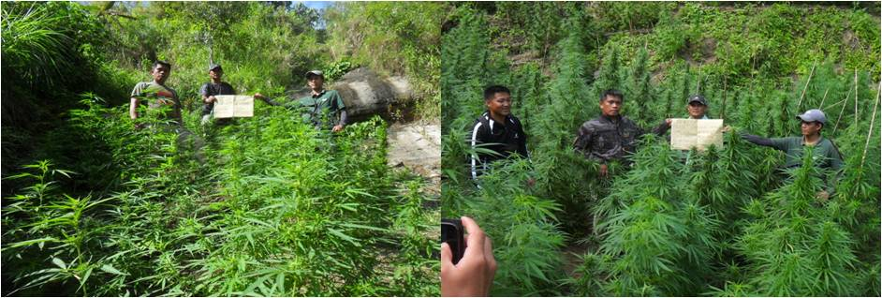
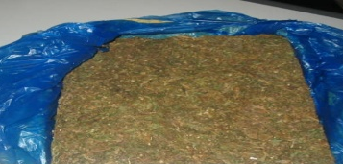
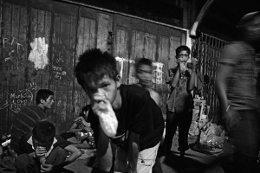
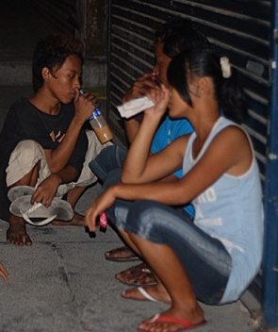
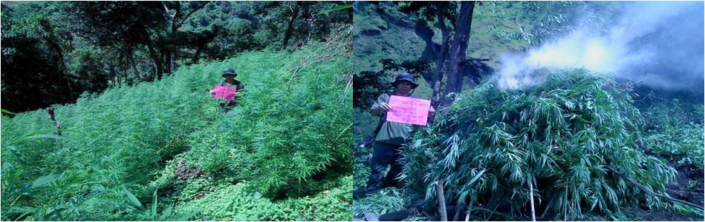
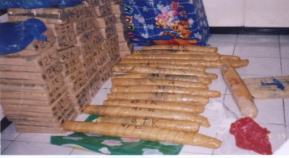
CURRENT REALITIES
Most Abused Illegal Drugs
    Methamphetamine Hydrochloride
Ecstasy
Cannabis or Marijuana
Inhalants
Source: DDB
Notes:
The most abused drug of choice is still methamphetamine hydrochloride popularly known as shabu followed by cannabis or marijuana. Third is Ecstasy which are usually being used by affluent members of the society mostly in clubs during parties. Lastly are the inhalants which are commonly abused by street children.

Slide 4
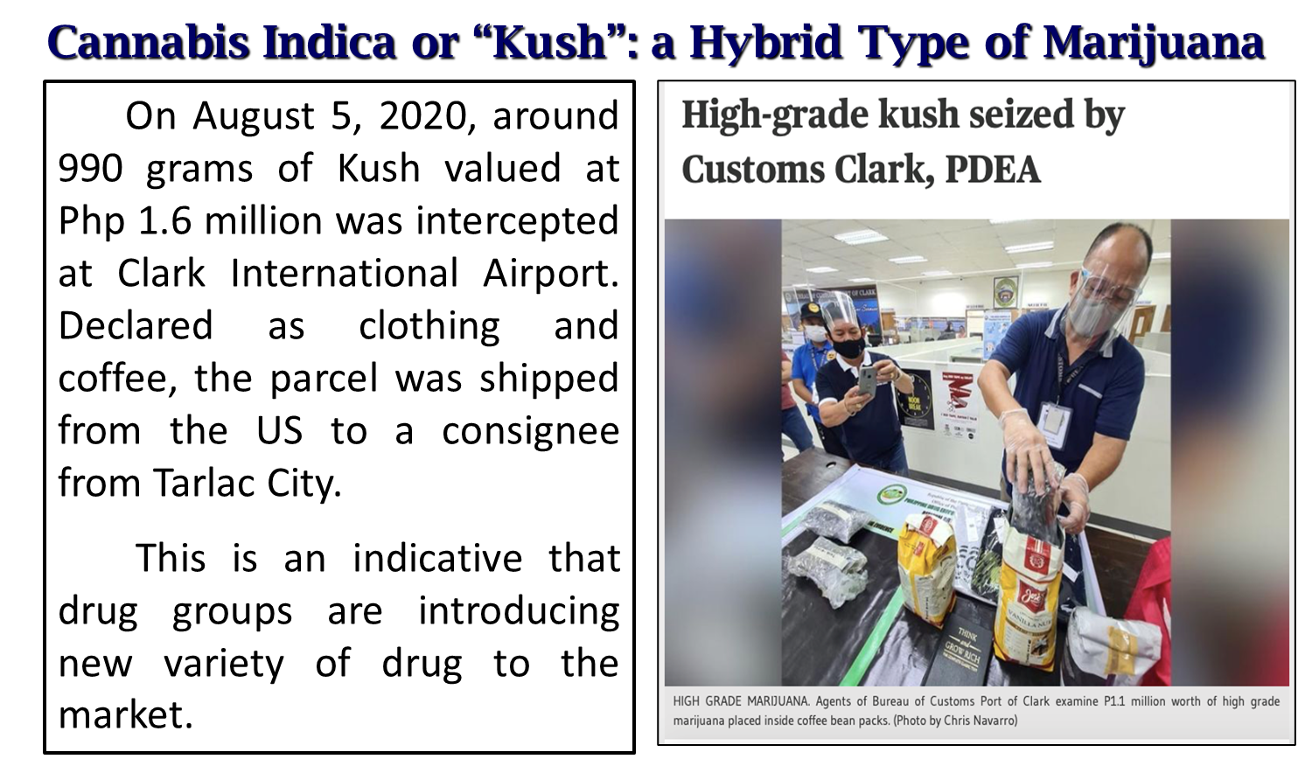
CURRENT REALITIES
Most Abused Illegal Drugs
Source: DDB

Slide 5
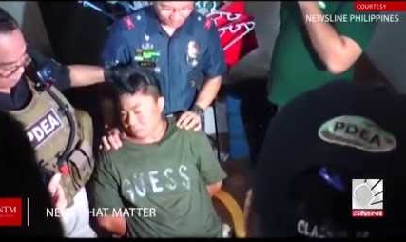
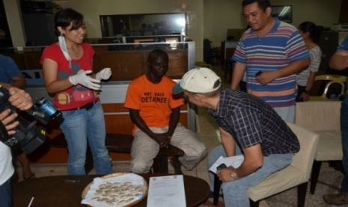
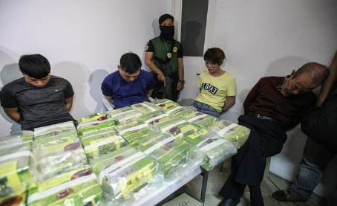
CURRENT REALITIES
Drug Syndicates
Chinese Drug Syndicate dominates the drug market in the country. They facilitate production, manufacturing and bulk smuggling of dangerous drugs.
African Drug Syndicate (ADS) is responsible for the smuggling of illegal drugs through the airports using drug couriers/ swallowers.
Local Drug Syndicates is responsible for the conduct drug trafficking activities within their territorial jurisdiction wholesale and retail distribution of drugs and maintenance of dens.
Notes:
The Chinese or Filipino-Chinese drug syndicate dominates the drug market in the country. They facilitate production, manufacturing and bulk smuggling of dangerous drugs mostly from mainland china and are being diverted to other nearby countries. Next are the African Drug Syndicate, they responsible for the smuggling of illegal drugs through the airports using filipino domestic workers and those who were promised of marriage as drug couriers/ swallowers. The local drug syndicates or the so called territorial traffickers are responsible in the wholeasale and retail distribution of illegal drugs and maintenance of dens within their jurisdiction. Local drug syndicates are usually tied-up with Chinese syndicates as their suppliers.
Because of the intensified anti-illegal drugs campaign of the national government, transnational drug syndicates are now shifting their method of operations from manufacturing or maintenance of clandestine Meth laboratories to importation and smuggling of illegal drugs through the airport, seaport, mail and parcel service, and the vast coastlines of the country.

Slide 6
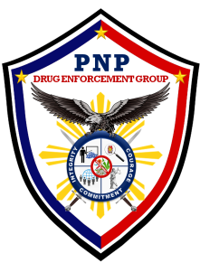
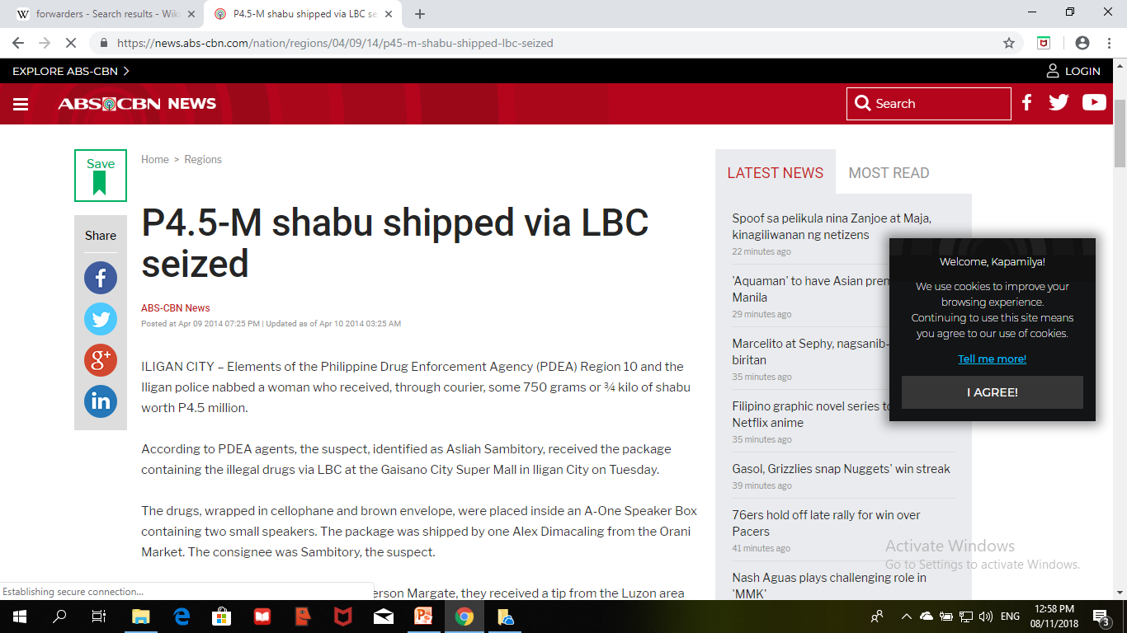
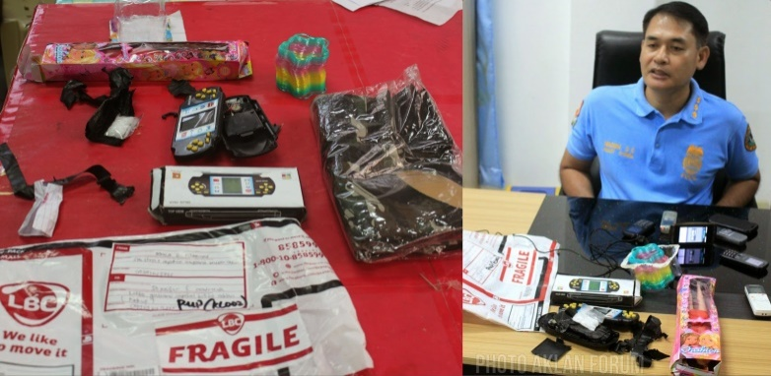
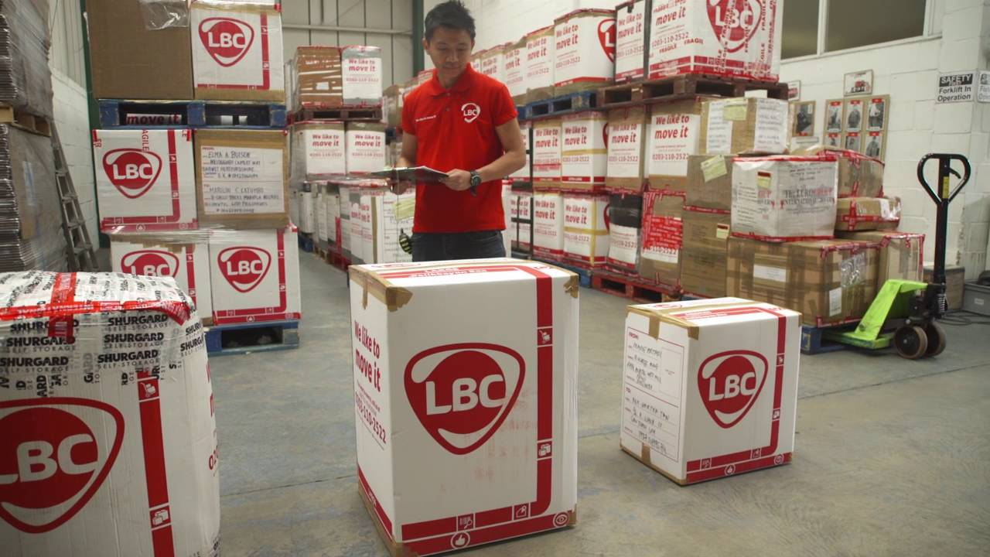
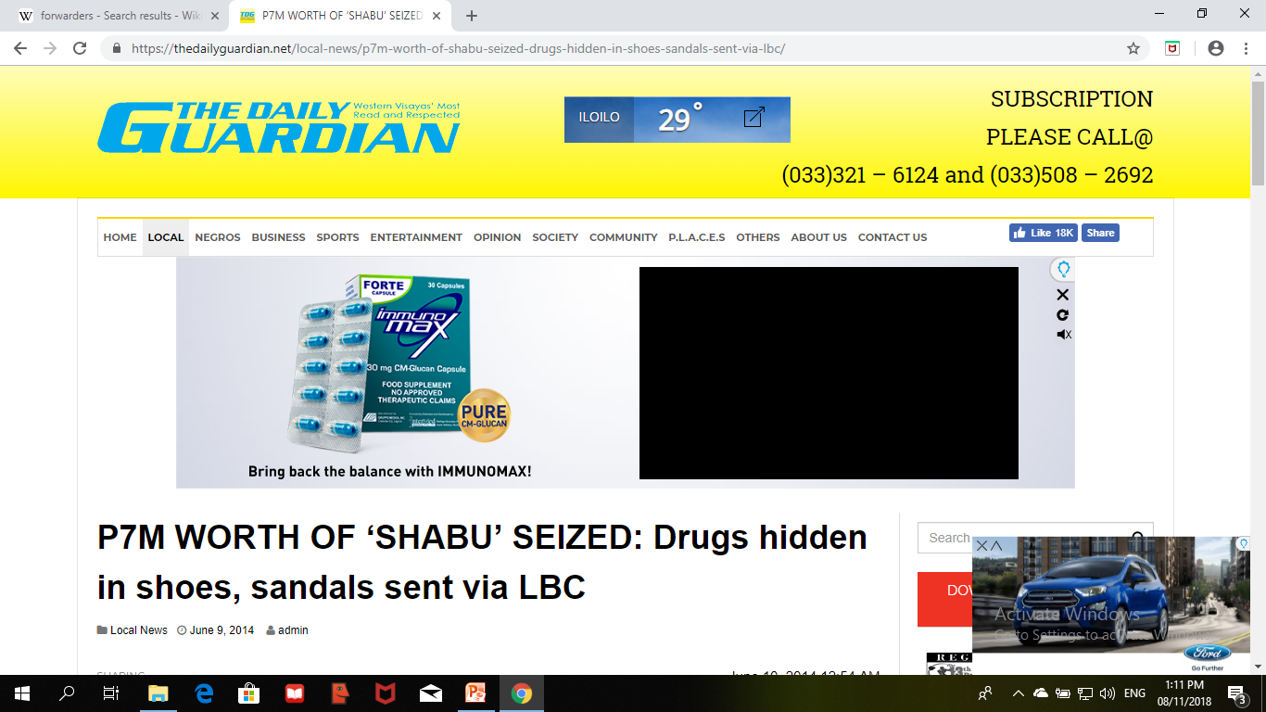
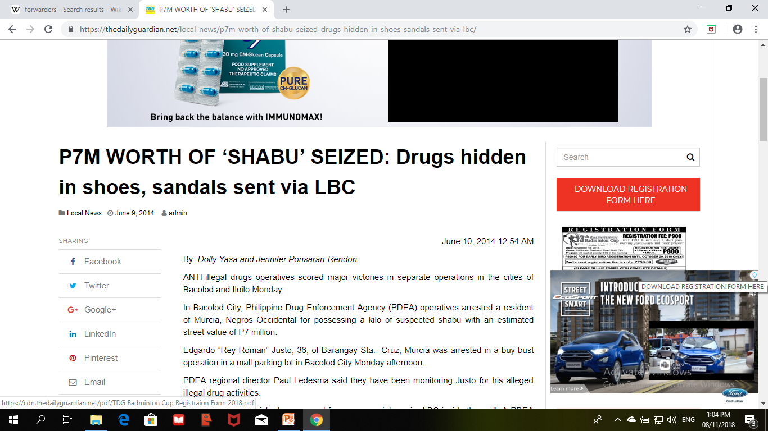
Current Realities
Delivery via Forwarders and Couriers

Slide 7
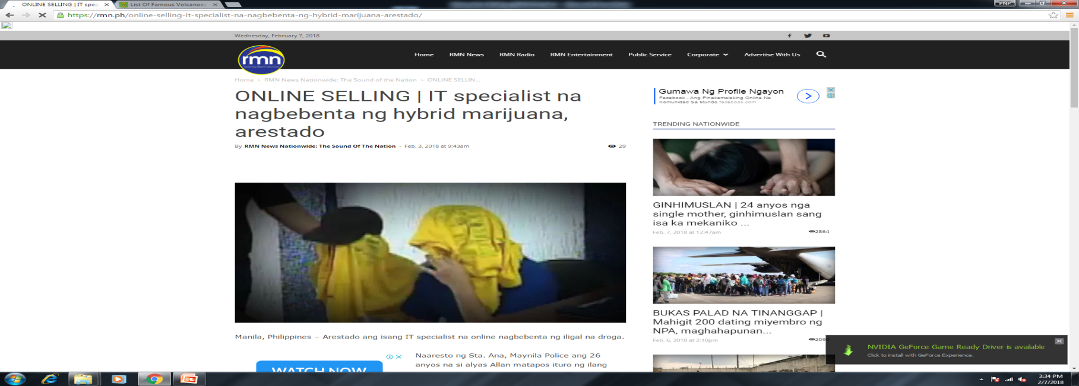
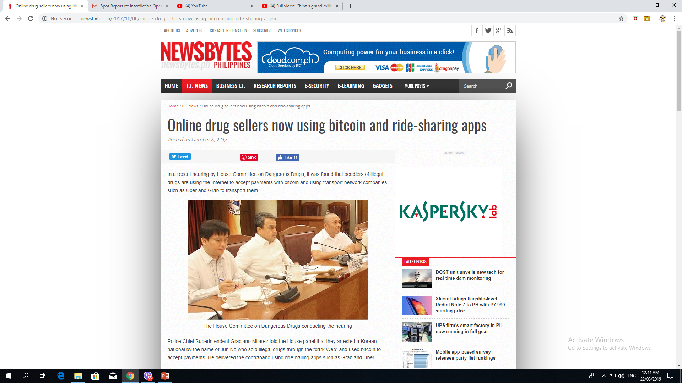
Current Realities
Online selling of illegal drugs

Slide 8
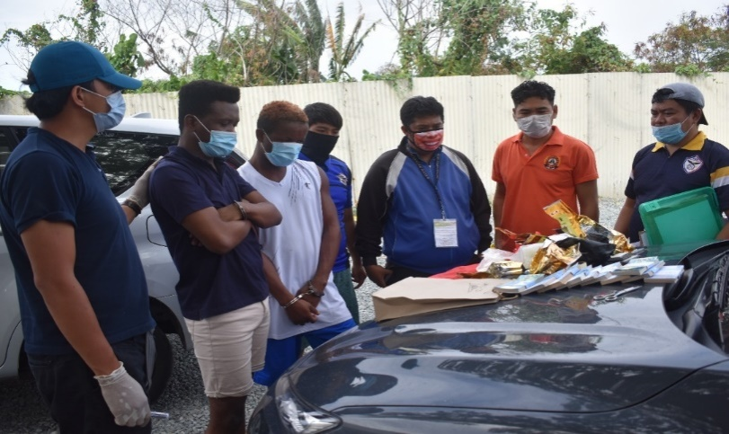
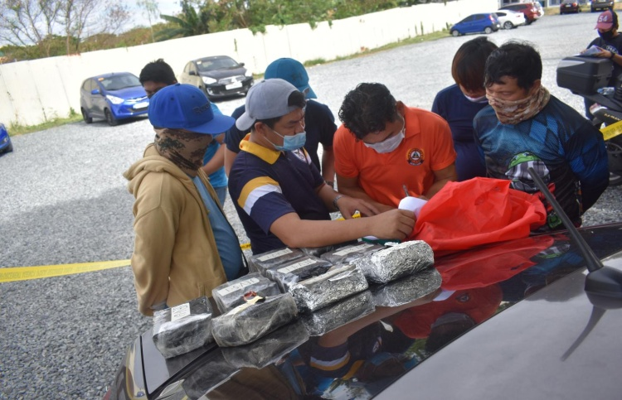
OPERATIONAL ACCOMPLISHMENTS
MARCH 17- DEC 31, 2020
7
10
OPERATIONS CONDUCTED | PERSONS ARRESTED | DIED IN POLICE OPERATIONS | SEIZED ITEM |  |  |  |  | STANDARD DRUG PRICE OF SEIZED ILLEGAL DRUGS (Php)
 |  |  | Shabu (grams) | Ecstasy (pieces) | Ephedrine (grams) | Marijuana
 |  |  |  |  |  | Plants (pieces) | Dried Leaves (gms)
66 | 93 | 11 | 1,354,195 | 1,000 | 1,983.16 | 5,000 | 217,000 | Php 9,237,372,099.32
Notes:
Covering the period of March 17 to December 31, 2020 the PNP Drug Enforcement Group was able to conduct 66 anti-illegal drug operations that resulted in the arrest of 93 drug personalities, death of 11 drug suspects and confiscation of various kinds of prohibited drugs amounting to almost 9.3 Billion pesos based on the standard drug price set by the Dangerous Drugs Board.

Slide 9
COMPARATIVE DATA
(Mar 17-Dec 31, 2019 & Mar 17- Dec 31, 2020)
181.8% increase on illegal drug confiscations
Notes:
Comparing the data of March 17 to December 31 of year 2020 versus the same period of year 2019, a huge increase in the seizure of illegal drugs was recorded. The increase in the confiscation is more or less 6 Billion pesos worth of illegal drugs or 181.8 percent.

Slide 10
Assessment
The 181.8% increase of confiscated illegal drugs shows that drug traffickers are taking advantage of the situation.
Actual street price of dangerous drugs, specifically “Shabu” has substantially increased based on reports from SOUs PNP DEG

Slide 11
Assessment
Despite the COVID-19 pandemic, this Group will continuously perform our mandated functions to attain the PNP DEG Vision and Mission to achieve a drug-free Philippines.
Minimum health standards and existing protocols on COVID-19 will be strictly observed by this Group and ensure that welfare the of personnel are takien into consideration during the conduct of anti-illegal drug operations.

Slide 12
Assessment
Drug groups quickly adopted to the new normal situation and introduced a new landscape of trafficking illegal drugs in the country.
From traditional to a highly compartmentalized, complicated and comprehensive organization, transnational drug trafficking and illegal drug business continuously evolve.

Slide 13
Assessment
The strict implementation of the anti-drug campaign in the airports and seaports, prompted the drug syndicates to change their modus operandi through shipside smuggling considering the porous borders and unpatrolled shorelines of the country.
Thus, the insufficient capabilities to guard the shores of the many islands of the country will remain to be a challenge to the government.

Slide 14
Assessment
Thus, cooperation and timely coordination with PDEA and other drug units will result into more interdiction operations in the country.

Slide 15
End of Presentation

