Slide 1
ISSUP - Philippines
ADDICTION & BEHAVIORAL HEALTH:
Emerging Issues, Realities & Siver Linings in Prevention, Treatment and Recovery
Amidst the Pandemic...
from the Perspective of a Clinician
Dr. Miriam P. Cue, PhD. RPsy, RGC, RPm, ICAP III

Slide 2

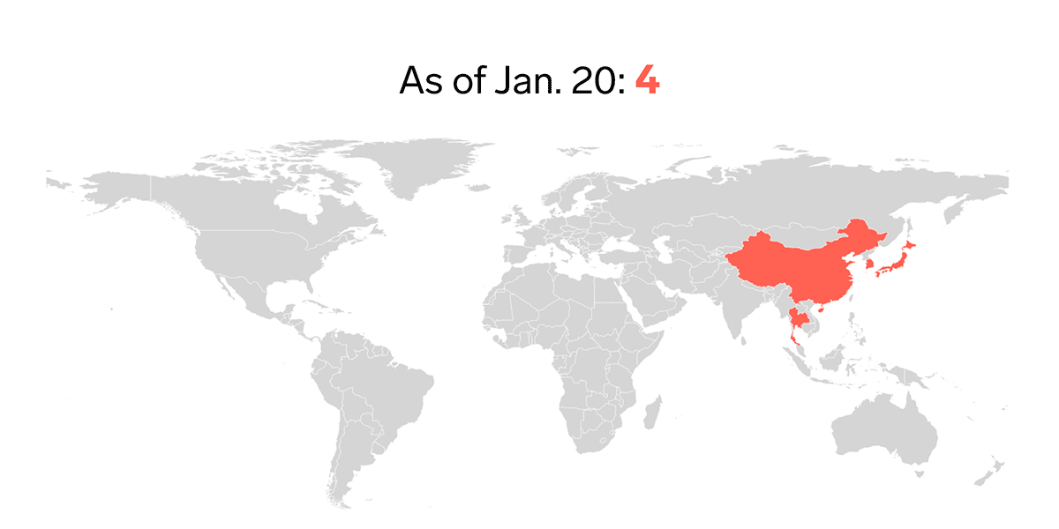
We are facing a Global Mental Health Crisis..
How are the PWUDs in the Philippines fairing during this pandemic?

Slide 3
SOURCES
Private Clinical Practice
Residential Treatment
Community / Church Based Treatment
Government Outpatient Treatment

Slide 4
01
ISSUES &
CHALLENGES

Slide 5
ISSUES AND CHALLENGES
1
Stress, anxiety tension and depression, frustration and anger due to unprecedented changes, drastic lifestyle changes, isolation and perceived restrictions in the environment.
2
Boredom and pandemic fatigue due to limited mobility restricted social activities and the long long wait for things to go back to the way they used to be.
3
Work-related financial issues/ opportunities, low morale; status problems due to loss of jobs, loss of employment and/or business opportinities, reduced wor hours, limited opportunities to find meaningful work
4
Hampered business and travel plans
Working from home amidst all the tensions and conflicts within the family

Slide 6
ISSUES AND CHALLENGES
7
Changes in service continuity plan/ mode of service delivery.
8
Limited access to counseling/ teleconsul-tation due to internet connection issues unavailability of gadgets (phones and/or laptops)
9
More pronounced co-occuring Disorders, particularly psychiatic symptoms
6
5
Family pressure, problems and conflicts.
Frustration due to needed adjustment/ changes in the program treatment structure
Limited face-to-face outdoor contact with PPE.
Use of help line and virtual counseling or consultation
Increased vulnerability to use- relapse.

Slide 7
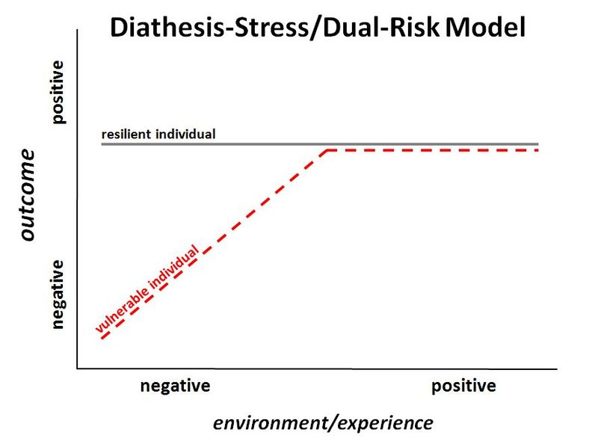

Slide 8
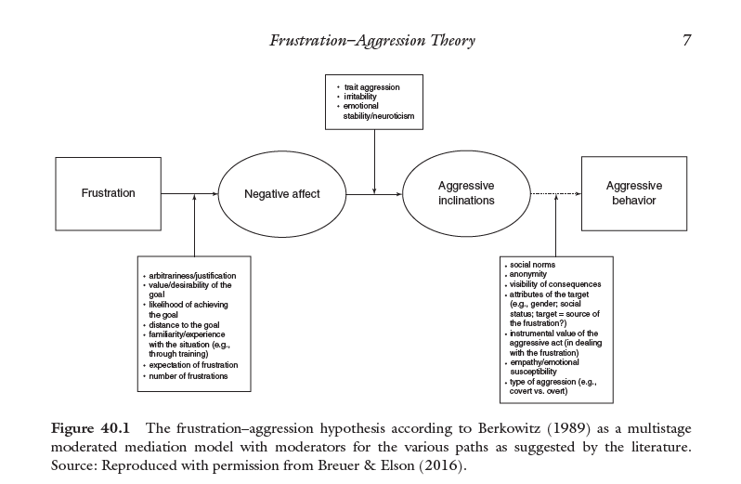
Notes:
a theory of aggression proposed by John Dollard, Neal Miller, Leonard Doob, Orval Mowrer, and Robert Sears in 1939,^{[1]} and further developed by Neal Miller in 1941^{[2]} and Leonard Berkowitz in 1969.^{[3]} The theory says that aggression is the result of blocking, or frustrating, a person's efforts to attain a goal.
When first formulated, the hypothesis stated that frustration always precedes aggression, and aggression is the sure consequence of frustration.^{[1]} Two years later, however, Miller^{[2]} and Sears^{[5]} re-formulated the hypothesis to suggest that while frustration creates a need to respond, some form of aggression is one possible outcome. Therefore, the re-formulated hypothesis stated that while frustration prompts a behavior that may or may not be aggressive, any aggressive behavior is the result of frustration, making frustration not sufficient, but a necessary condition for aggression.^{[6]}

Slide 9
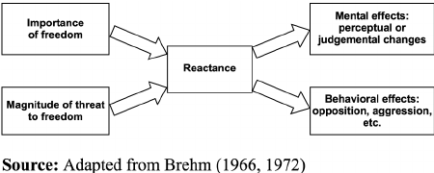
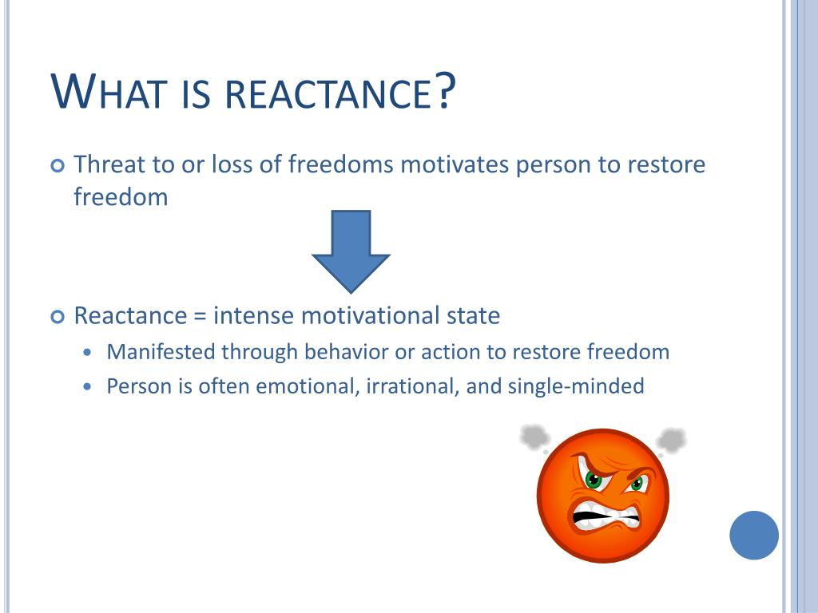
Reactance Theory
Brehm, 1966, 1972
Notes:
a model stating that in response to a perceived threat to—or loss of—a behavioral freedom, a person will experience psychological reactance (or, more simply, reactance), a motivational state characterized by distress, anxiety, resistance, and the desire to restore that freedom. According to this model, when people feel coerced into a certain behavior, they will react against the coercion, often by demonstrating an increased preference for the behavior that is restrained, and may perform the behavior opposite to that desired. [proposed in 1966 Jack W. Brehm].

Slide 10
02
REALITIES

Slide 11
REALITIES
(1) Limited availability and Supply of Substances
IMPACT:
Limited accessibility to the substance among the poor
Easy access by delivery for the affluent
T
(2) Restriction to gathering/s
IMPACT:
Isolated-using (at home)
Reduced peer pressure

Slide 12
03
SILVER LININGS
DURING THE LOCKDOWN

Slide 13
SILVER LININGS
Increased insight of the PWUDs in the community that independence from the substance is possible.
More active engagement of the families in the treatment program.
Turning to faith and more mature spirituality
MORE ACTIVE iNVOLVEMENT
Taking Iinitiative for their own treatment & follow up sessions.

Slide 14
SILVER LININGS
Realization of the Public that -
Substance Use is a Mental Health Issue
We all need to take care of ourselves and our own mental health, especially in these trying times
There is a need to arrive at a more effective approach to Prevention,
Treatment and Recovery
sensitive to culture, beliefs
and traditions...
Philippine Model of Intervention for PWUDs
Notes:
Turning to faith and more mature spirituality

Slide 15

Alternative Resources

Slide 16


